Slide 1

Declarative Analytics on Heterogeneous HPC Systems
Ahmedur Rahman Shovon
Committee:
Dr. Sidharth Kumar, Chair and Advisor
Dr. Michael E. Papka
Dr. Zhiling Lan
Dr. Stavros Sintos
Dr. Gopikrishna Deshpande (AU)
Dr. Thomas Gilray (WSU)
July 15, 2025

Slide 2
Roadmap
Introduction and motivation
GPU based Datalog engine development
Multi-node multi-GPU Datalog engine development
GPU portability of Datalog engines
Power analysis of Datalog engines
Exploration of high-dimensional scientific analytics
Future work
Conclusion

Slide 3
Declarative Programming Paradigm
Introduction
Single-GPU Engines
Multi-node Multi-GPU
Scientific Analytics
GPU Portability
Power Analysis
Future Work
Conclusion
Users expresses what to achieve with the data rather than how to accomplish it
Employees
EmpID | Name | Email | Age | ManagerID
0 | Alice | alice@example.com | 56 | Null
1 | Bob | bob@example.com | 33 | 0
2 | Eve | eve@example.com | 26 | 0
3 | Carol | carol@example.com | 34 | 2
4 | Dave | dave@example.com | 22 | 3
Find all employees who are less than 30 years old
SELECT Name FROM Employees WHERE Age < 30;
Lloyd, J. W. (1994, September). Practical Advantages of Declarative Programming. In GULP-PRODE (1) (pp. 18-30).
Notes:
Declarative analytics enables users to focus on what they want to achieve with the data, rather than worrying about how it is computed

Slide 4
How is the query processed?
Introduction
Single-GPU Engines
Multi-node Multi-GPU
Scientific Analytics
GPU Portability
Power Analysis
Future Work
Conclusion
SQL Statement
WHAT
SELECT Name FROM Employees WHERE Age < 30;
Database Engine
Parse statement
Validate statement
HOW
Generate multiple execution plans
Query optimization
Query execution
Result set
Processing a SQL statement. Microsoft. https://learn.microsoft.com/en-us/sql/odbc/reference/processing-a-sql-statement?view=sql-server-2017
Notes:
Declarative analytics enables users to focus on what they want to achieve with the data, rather than worrying about how it is computed

Slide 5
Recursive Queries using SQL
Introduction
Single-GPU Engines
Multi-node Multi-GPU
Scientific Analytics
GPU Portability
Power Analysis
Future Work
Conclusion
Employees
1
EmpID | Name | Email | Age | ManagerID
0 | Alice | alice@example.com | 56 | Null
1 | Bob | bob@example.com | 33 | 0
2 | Eve | eve@example.com | 26 | 0
3 | Carol | carol@example.com | 34 | 2
4 | Dave | dave@example.com | 22 | 3
G
1
T
0
3
4
0
3
4
2
2
Find all managers, including direct and indirect managers.
-- Recursive CTE to find all managers (direct and indirect)
WITH RECURSIVE ManagerHierarchy AS ( -- Base case: direct manager relationship SELECT EmpID AS EmployeeID, ManagerID FROM Employees WHERE ManagerID IS NOT NULL UNION -- Recursive case: find manager of managers recursively SELECT mh.EmployeeID, e.ManagerID FROM ManagerHierarchy mh JOIN Employees e ON mh.ManagerID = e.EmpID WHERE e.ManagerID IS NOT NULL )
SELECT DISTINCT ManagerID, Employeeid FROM ManagerHierarchy ORDER BY ManagerID;
Advanced approach: Datalog
Notes:
Declarative analytics enables users to focus on what they want to achieve with the data, rather than worrying about how it is computed

Slide 6
Recursive Queries using Datalog
Introduction
Single-GPU Engines
Multi-node Multi-GPU
Scientific Analytics
GPU Portability
Power Analysis
Future Work
Conclusion
Employees
1
EmpID | Name | Email | Age | ManagerID
0 | Alice | alice@example.com | 56 | Null
1 | Bob | bob@example.com | 33 | 0
2 | Eve | eve@example.com | 26 | 0
3 | Carol | carol@example.com | 34 | 2
4 | Dave | dave@example.com | 22 | 3
G
1
T
0
3
4
0
3
4
2
2
Find all managers, including direct and indirect managers.
Finding recursive relationships using Datalog
// Base case: direct manager manages employee
Manager(mID, eID) :- Employees(eID, mID), mID != NULL.
// Recursive case: indirect managers
Manager(mID, eID) :- Manager(mID, nID), Employees(eID, nID).
Notes:
Declarative analytics enables users to focus on what they want to achieve with the data, rather than worrying about how it is computed

Slide 7
Advantages of Recursive Queries with Datalog
Introduction
Single-GPU Engines
Multi-node Multi-GPU
Scientific Analytics
GPU Portability
Power Analysis
Future Work
Conclusion
1
G
1
T
Find all managers, including direct and indirect managers.
0
3
4
0
3
4
2
2
Finding recursive relationships using SQL
Finding recursive relationships using Datalog
-- Recursive CTE to find all managers (direct and indirect)
WITH RECURSIVE ManagerHierarchy AS ( -- Base case: direct manager relationship SELECT EmpID AS EmployeeID, ManagerID FROM Employees
WHERE ManagerID IS NOT NULL UNION -- Recursive case: find manager of managers recursively SELECT mh.EmployeeID, e.ManagerID FROM ManagerHierarchy mh JOIN Employees e ON mh.ManagerID = e.EmpID
WHERE e.ManagerID IS NOT NULL )
SELECT DISTINCT ManagerID, EmployeeID FROM ManagerHierarchy ORDER BY ManagerID;
Datalog offers greater expressiveness and natural syntax for recursive queries
// Base case: direct manager manages employee
Manager(mID, eID) :- Employees(eID, mID), mID != NULL.
// Recursive case: indirect managers
Manager(mID, eID) :- Manager(mID, nID), Employees(eID, nID).
As a logic programming language, it’s well-suited for deductive databases
Ideal for declarative analytics to find complex patterns over large datasets
Shovon, A. R. (2024, April 23). Recursive queries in SQL and Datalog. Ahmedur Rahman Shovon. Retrieved June 22, 2024, from https://arshovon.com/blog/recursive-queries/
Notes:
Declarative analytics enables users to focus on what they want to achieve with the data, rather than worrying about how it is computed

Slide 8
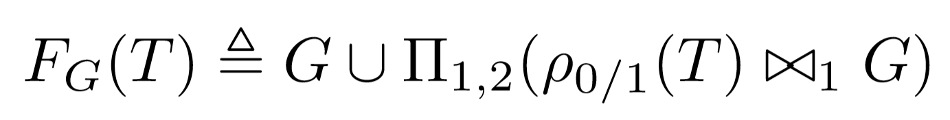
Datalog Rules Execution
Introduction
Single-GPU Engines
Multi-node Multi-GPU
Scientific Analytics
GPU Portability
Power Analysis
Future Work
Conclusion
Datalog Rules
Datalog Engine
Iterative Relational Algebra
// Base case: direct manager manages employee
Manager(mID, eID) :- Employees(eID, mID), mID != NULL.
// Recursive case: indirect managers
Manager(mID, eID) :- Manager(mID, nID), Employees(eID, nID).
Parse rules
Generate query plan
Union
Projection
Join
Relational algebra operations
Loop until manager_{i} = manager_{i-1}
Gilray, T., & Kumar, S. (2019, December). Distributed relational algebra at scale. In 2019 IEEE 26th International Conference on High Performance Computing, Data, and Analytics (HiPC) (pp. 12-22). IEEE.

Slide 9
Manager Chains Problem as Transitive Closure
Introduction
Single-GPU Engines
Multi-node Multi-GPU
Scientific Analytics
GPU Portability
Power Analysis
Future Work
Conclusion
Find all managers, including direct and indirect managers.
1
G
1
T
// Base case: direct manager manages employee
Manager(mID, eID) :- Employees(eID, mID), mID != NULL.
// Recursive case: indirect managers
Manager(mID, eID) :- Manager(mID, nID), Employees(eID, nID).
0
3
4
0
3
4
2
2
Transitive closure computation of a graph
0​ | 1​
0​ | 2​
2​ | 3​
3​ | 4​
0​ | 3​
2​ | 4​
0​ | 4​
0​ | 1​
0 | 2​
2​ | 3​
3 | 4
tc(X, Y) :- edges(X, Y).
tc(X, Z) :- tc(X, Y), edges(Y, Z).

Slide 10
Transitive Closure: Iterations 1
Introduction
Single-GPU Engines
Multi-node Multi-GPU
Scientific Analytics
GPU Portability
Power Analysis
Future Work
Conclusion
1
T
0
3
4
2
0​ | 1​
0​ | 2​
2​ | 3​
3​ | 4​

Slide 11
Transitive Closure: Iterations 1
Introduction
Single-GPU Engines
Multi-node Multi-GPU
Scientific Analytics
GPU Portability
Power Analysis
Future Work
Conclusion
ρ_{0/1}(T)
G
1 | 0
2​ | 0
3 | 2
4​ | 3
⨝
0​ | 1​
0​ | 2​
2​ | 3​
3​ | 4​

Slide 12
Transitive Closure: Iterations 1
Introduction
Single-GPU Engines
Multi-node Multi-GPU
Scientific Analytics
GPU Portability
Power Analysis
Future Work
Conclusion
ρ_{0/1}(T)
G
ρ_{0/1}(T) ⨝ G
1 | 0
2​ | 0
3 | 2
4​ | 3
⨝
0​ | 1​
0​ | 2​
2​ | 3​
3​ | 4​
2 | 0 | 3

Slide 13
Transitive Closure: Iterations 1
Introduction
Single-GPU Engines
Multi-node Multi-GPU
Scientific Analytics
GPU Portability
Power Analysis
Future Work
Conclusion
ρ_{0/1}(T)
G
ρ_{0/1}(T) ⨝ G
1 | 0
2​ | 0
3 | 2
4​ | 3
⨝
0​ | 1​
0​ | 2​
2​ | 3​
3​ | 4​
1 | 0 | 3
3 | 2 | 4

Slide 14
Transitive Closure: Iterations 1
Introduction
Single-GPU Engines
Multi-node Multi-GPU
Scientific Analytics
GPU Portability
Power Analysis
Future Work
Conclusion
ρ_{0/1}(T)
G
ρ_{0/1}(T) ⨝ G
Π_{1, 2}(ρ_{0/1}(T) ⨝ G)
1 | 0
2​ | 0
3 | 2
4​ | 3
⨝
0​ | 1​
0​ | 2​
2​ | 3​
3​ | 4​
1 | 0 | 3
3 | 2 | 4
0 | 3
2 | 4

Slide 15
Transitive Closure: Iterations 1
Introduction
Single-GPU Engines
Multi-node Multi-GPU
Scientific Analytics
GPU Portability
Power Analysis
Future Work
Conclusion
1
1
T
0
3
4
0
3
4
2
2
0​ | 1​
0​ | 2​
2​ | 3​
3​ | 4​
0​ | 1​
0​ | 2​
2​ | 3​
3​ | 4​
0​ | 3​
2​ | 4​

Slide 16
Transitive Closure: Iterations 2
Introduction
Single-GPU Engines
Multi-node Multi-GPU
Scientific Analytics
GPU Portability
Power Analysis
Future Work
Conclusion
1
1
1
T
0
3
4
0
3
4
0
3
4
2
2
2
0​ | 1​
0​ | 2​
2​ | 3​
3​ | 4​
0​ | 1​
0​ | 2​
2​ | 3​
3​ | 4​
0​ | 3​
2​ | 4​
0​ | 1​
0​ | 2​
2​ | 3​
3​ | 4​
0​ | 3​
2​ | 4​
0​ | 4​

Slide 17
Transitive Closure: Iterations 3
Introduction
Single-GPU Engines
Multi-node Multi-GPU
Scientific Analytics
GPU Portability
Power Analysis
Future Work
Conclusion
Fixed-point reached
1
1
1
1
T
0
3
4
0
3
4
0
3
4
0
3
4
2
2
2
2
0​ | 1​
0​ | 2​
2​ | 3​
3​ | 4​
0​ | 1​
0​ | 2​
2​ | 3​
3​ | 4​
0​ | 3​
2​ | 4​
0​ | 1​
0​ | 2​
2​ | 3​
3​ | 4​
0​ | 3​
2​ | 4​
0​ | 4​
0​ | 1​
0​ | 2​
2​ | 3​
3​ | 4​
0​ | 3​
2​ | 4​
0​ | 4​

Slide 18
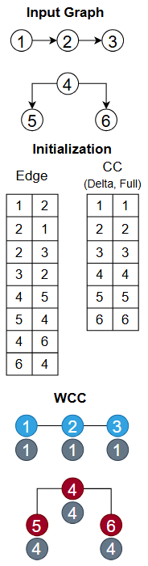
Graph Mining Applications
Introduction
Single-GPU Engines
Multi-node Multi-GPU
Scientific Analytics
GPU Portability
Power Analysis
Future Work
Conclusion
Applications
Transitive closure
Connected components
Same generation
Triangle counting
tc(X, Y) :- edges(X, Y).
tc(X, Z) :- tc(X, Y), edges(Y, Z).
cc(X, X) :- edges(X, _).
cc(Y, $MIN(Z)) :- cc(Y, Z), edges(X, Y).
2cl(X, Y) :- edges(X, Y), X < Y.
2cl(X, Y) :- edges(Y, X), X < Y.
triangles(X, Y, Z) :- 2cl(X, Y), 2cl(Y, Z), 2cl(X, Z).
sg(x, y) :- edges(p, x), edges(p, y), x ≠ y.
sg(x, y) :- edges(a, x), sg(a, b), edges(b, y), x ≠ y.
De Moor, O., Gottlob, G., Furche, T., & Sellers, A. (Eds.). (2012). Datalog Reloaded: First International Workshop, Datalog 2010, Oxford, UK, March 16-19, 2010. Revised Selected Papers (Vol. 6702). Springer.
Huang, S. S., Green, T. J., & Loo, B. T. (2011, June). Datalog and emerging applications: an interactive tutorial. In Proceedings of the 2011 ACM SIGMOD International Conference on Management of data (pp. 1213-1216).
Gilray, T., & Kumar, S. (2017). Toward parallel cfa with datalog, mpi, and cuda. In Scheme and Functional Programming Workshop.
Zomorodian, A. (2012). Topological data analysis. Advances in applied and computational topology, 70, 1-39.

Slide 19
Introduction
Single-GPU Engines
Multi-node Multi-GPU
Scientific Analytics
GPU Portability
Power Analysis
Future Work
Conclusion
Datalog’s Applications
Graph
mining
Static
analysis
Deductive database
Machine
learning
Datalog
Iterative Relational Algebra
Notes:
Graph Mining for community detection
Static Analysis analyzing program behavior, such as identifying bugs, verifying security properties, or performing dependency analysis
Deductive Databases for complex recursive queries
Machine Learning for explainable AI
Its declarative nature makes it ideal for scaling these tasks on heterogeneous exascale systems

Slide 20
Limitations of Current Datalog Engines
Introduction
Single-GPU Engines
Multi-node Multi-GPU
Scientific Analytics
GPU Portability
Power Analysis
Future Work
Conclusion
Multi-threaded
Distributed
(Apache Spark)
Multi-node
Multi-threaded
Single-GPU
Multi-node
Multi-GPU
Soufflé
RDFox
SLOG
GPUJoin
LogicBlox
Radlog
PRAM
GPULog
Nemo
BigDatalog
GPUDatalog
Scalability
Framework
CPU-only
VRAM
Herbert Jordan, Bernhard Scholz, and Pavle Subotić. 2016. Soufflé: On synthesis of program analyzers. In Computer Aided Verification: 28th International Conference, CAV 2016, Toronto, ON, Canada, July 17-23, 2016, Proceedings, Part II 28, Swarat Chaudhuri and Azadeh Farzan (Eds.). Springer, Springer International Publishing, Cham, 422–430.
Boris Motik, Yavor Nenov, Robert Piro, Ian Horrocks, and Dan Olteanu. 2014. Parallel materialisation of datalog programs in centralised, main-memory RDF systems. In Proceedings of the AAAI Conference on Artificial Intelligence, Vol. 28.
Shkapsky, A., Yang, M., Interlandi, M., Chiu, H., Condie, T., & Zaniolo, C. (2016, June). Big data analytics with datalog queries on spark. In Proceedings of the 2016 International Conference on Management of Data (pp. 1135-1149).
Yavor Nenov, Robert Piro, Boris Motik, Ian Horrocks, Zhe Wu, and Jay Banerjee. 2015. RDFox: A Highly-Scalable RDF Store. In The Semantic Web - ISWC 2015, Marcelo Arenas, Oscar Corcho, Elen Simperl, Markus Strohmaier, Mathieu d’Aquin, Kavitha Srinivas, Paul Groth, Michel Dumontier, Jeff Heflin, Krishnaprasad Thirunarayan, and Steffen Staab (Eds.). Springer International Publishing, Cham, 3–20.
Thomas Gilray, Arash Sahebolamri, Yihao Sun, Sowmith Kunapaneni, Sidharth Kumar, and Kristopher Micinski. 2024. Datalog with First-Class Facts. Proc. VLDB Endow. 18, 3 (November 2024), 651–665.
Notes:
Multi-threaded: Limited scalability
Distributed: High overhead for introduced by Spark framework recursive queries
Multi-node Multi-threaded: Lacks GPU acceleration
Single-GPU: Bound by single GPU limitations

Slide 21






Introduction
Single-GPU Engines
Multi-node Multi-GPU
Scientific Analytics
GPU Portability
Power Analysis
Future Work
Conclusion
Motivation: Datalog on Multi-Node Multi-GPU Systems
Datalog
Relational algebra
Multi-node multi-GPU systems
Node 0
Node 1
Node n
High performance implementation for highly expressive language
High Bandwidth Network
Notes:
Write queries on a very high level language that runs on a supercomputer

Slide 22









Selected publications
Conference Proceedings
Towards iterative relational algebra on the {GPU}
Bruck Algorithm Performance Analysis for Multi-GPU All-to-All Communication
Optimizing Datalog for the GPU
Multi-node multi-GPU Datalog
Acceptance rate: 19%
Acceptance rate: 44%
Acceptance rate: 15%
Acceptance rate: 23%
Journal Articles
Workshop Papers
Submission
The robustness of persistent homology of brain networks to data acquisition‐related non‐neural variability in resting state fMRI
UALCAN: An update to the integrated cancer data analysis platform
Accelerating Datalog applications with cuDF
Scalable, interactive and hierarchical visualization of virus taxonomic data
Topology assisted clustering of temporal fMRI brain networks with use-case in mitigating non-neural multi-site variability
Impact factor: 5.0
Impact factor: 6.3
Acceptance rate: 42%

Slide 23
Selected publications
Conference Proceedings
Towards iterative relational algebra on the {GPU}
Bruck Algorithm Performance Analysis for Multi-GPU All-to-All Communication
Optimizing Datalog for the GPU
Multi-node multi-GPU Datalog
Acceptance rate: 19%
Acceptance rate: 44%
Acceptance rate: 15%
Acceptance rate: 23%
Journal Articles
Workshop Papers
Submission
The robustness of persistent homology of brain networks to data acquisition‐related non‐neural variability in resting state fMRI
UALCAN: An update to the integrated cancer data analysis platform
Accelerating Datalog applications with cuDF
Scalable, interactive and hierarchical visualization of virus taxonomic data
Topology assisted clustering of temporal fMRI brain networks with use-case in mitigating non-neural multi-site variability
Impact factor: 5.0
Impact factor: 6.3
Acceptance rate: 42%

Slide 24
Roadmap
Introduction and motivation
GPU based Datalog engine development
Multi-node multi-GPU Datalog engine development
GPU portability of Datalog engines
Power analysis of Datalog engines
Exploration of high-dimensional scientific analytics
Future work
Conclusion

Slide 25
GPU based Datalog engine development
Introduction
Single-GPU Engine: cuDF
Multi-node Multi-GPU
Scientific Analytics
GPU Portability
Power Analysis
Future Work
Conclusion
Off-the-shelf
Started with CPU and GPU based Python libraries
Compare GPU capabilities for iterative join operations
GPUJoin
Relational Algebra (RA) operations using CUDA
High performance GPU hashtable for iterative RA
GPULog
CUDA based SIMD API for deductive analytics
Novel Hash-Indexed Sorted Array data structure
Shovon, A. R., Dyken, L. R., Green, O., Gilray, T., & Kumar, S. (2022, November). Accelerating datalog applications with cudf. In 2022 IEEE/ACM Workshop on Irregular Applications: Architectures and Algorithms (IA3) (pp. 41-45). IEEE.

Slide 26

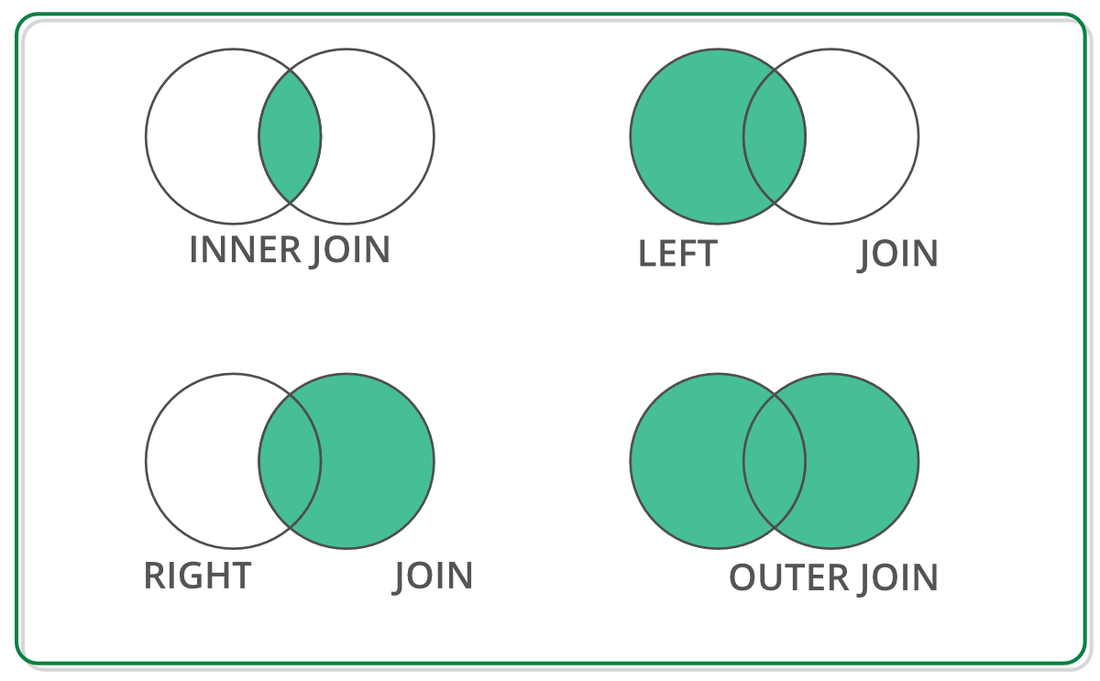
Off-the-shelf Data Structure for Join Operation
Introduction
Single-GPU Engine: cuDF
Multi-node Multi-GPU
Scientific Analytics
GPU Portability
Power Analysis
Future Work
Conclusion
DataFrame: tabular data structure
DataFrame has RA primitives APIs
Reback, J., McKinney, W., Van Den Bossche, J., Augspurger, T., Cloud, P., Klein, A., ... & Seabold, S. (2020). pandas-dev/pandas: Pandas 1.0. 5. Zenodo.
Chen, D. Y. (2017). Pandas for everyone: Python data analysis. Addison-Wesley Professional.
Singh, R. (2020, July 1). Merging DataFrames with Pandas: Pd.merge(). Medium. Retrieved April 8, 2023, from https://medium.com/swlh/merging-dataframes-with-pandas-pd-merge-7764c7e2d46d

Slide 27


Off-the-shelf Python Libraries
Introduction
Single-GPU Engine: cuDF
Multi-node Multi-GPU
Scientific Analytics
GPU Portability
Power Analysis
Future Work
Conclusion
DataFrame: 2D labeled tabular data structure
GPU (NVIDIA cuDF)
CPU
Both supports join operation with similar APIs
Reback, J., McKinney, W., Van Den Bossche, J., Augspurger, T., Cloud, P., Klein, A., ... & Seabold, S. (2020). pandas-dev/pandas: Pandas 1.0. 5. Zenodo.
Chen, D. Y. (2017). Pandas for everyone: Python data analysis. Addison-Wesley Professional.
Green, O., Du, Z., Patel, S., Xie, Z., Liu, H., & Bader, D. A. (2021, December). Anti-Section Transitive Closure. In 2021 IEEE 28th International Conference on High Performance Computing, Data, and Analytics (HiPC) (pp. 192-201). IEEE.
Fender, A., Rees, B., & Eaton, J. RAPIDS cuGraph. In Massive Graph Analytics (pp. 483-493). Chapman and Hall/CRC.

Slide 28
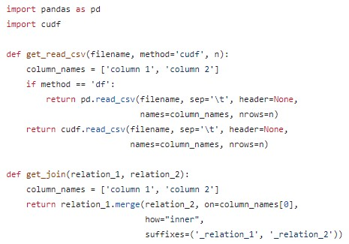
CPU (Pandas) and GPU (cuDF)
Introduction
Single-GPU Engine: cuDF
Multi-node Multi-GPU
Scientific Analytics
GPU Portability
Power Analysis
Future Work
Conclusion
CPU Environment
GPU Environment
https://github.com/harp-lab/GPUJoin/edit/main/IA3_2022/basic_operations.py

Slide 29
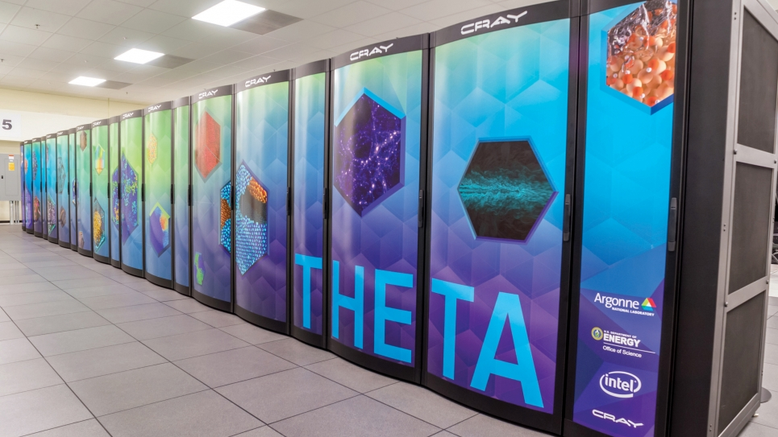
Evaluation environment, applications, datasets
Introduction
Single-GPU Engine: cuDF
Multi-node Multi-GPU
Scientific Analytics
GPU Portability
Power Analysis
Future Work
Conclusion
Apps: Transitive Closure, Triangle Counting
Datasets: Stanford large network, SuiteSparse, Road network
Argonne Leadership Computing Facility. 2022. Theta. https://www.alcf.anl.gov/alcf-resources/theta
Jure Leskovec and Andrej Krevl. 2014. SNAP Datasets: Stanford Large Network Dataset Collection. http://snap.stanford.edu/data
Timothy A. Davis and Yifan Hu. 2011. The University of Florida Sparse Matrix Collection. ACM Trans. Math. Softw. 38, 1, Article 1 (dec 2011), 25 pages. doi:10.1145/2049662.2049663
Notes:
Theta supercomputer from Argonne National Lab
CPU: AMD EPYC 7742
GPU: NVIDIA A100 GPU with 40GB VRAM
Software: cuDF (22.06), Pandas (1.4)

Slide 30
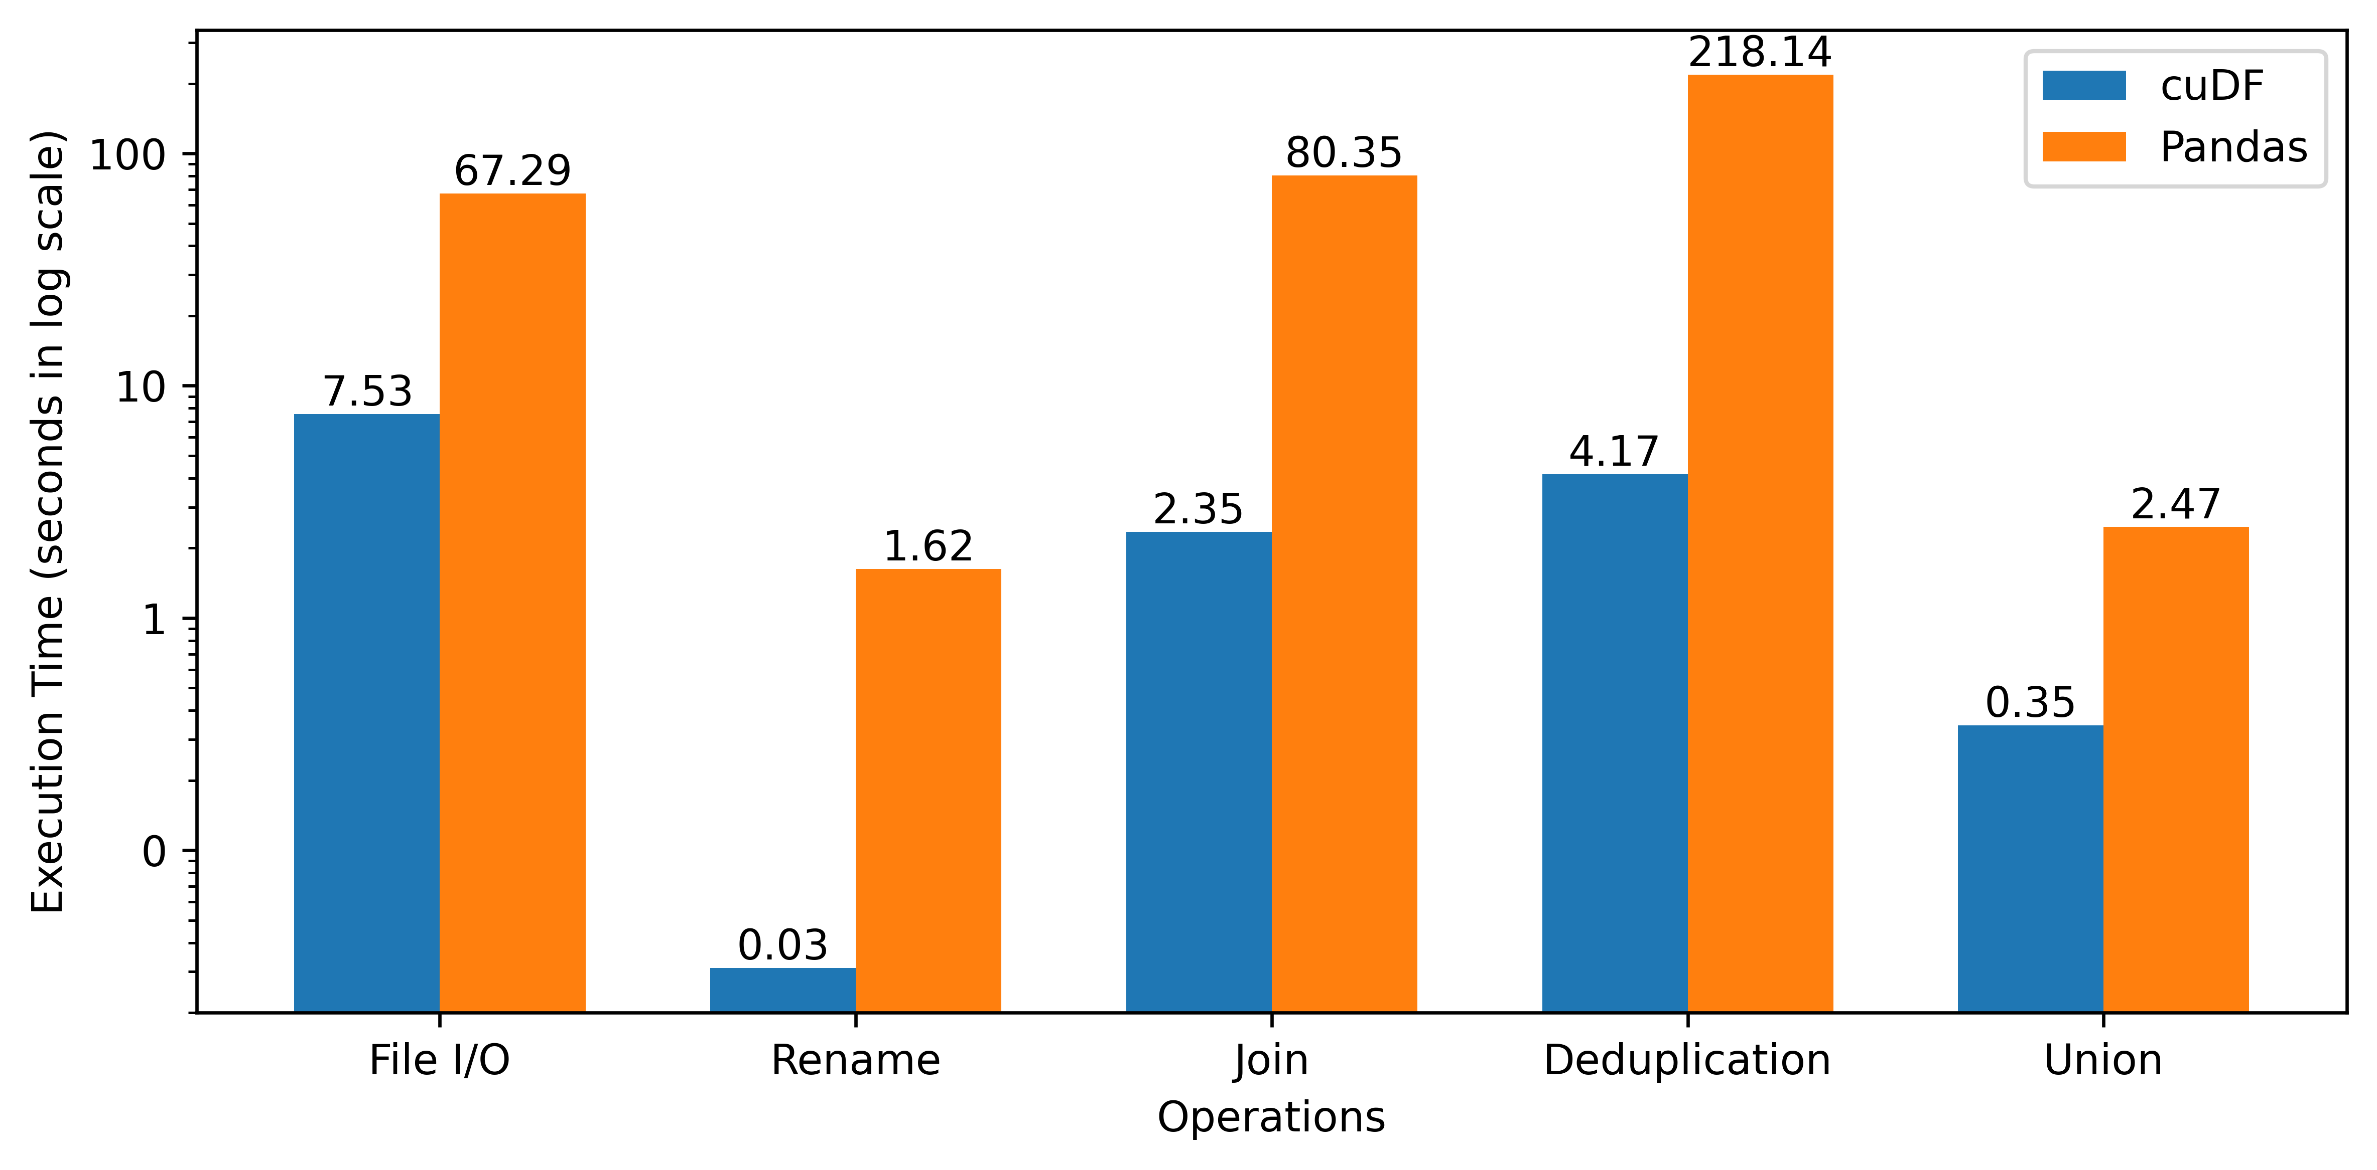
Performance Improvement for cuDF over Pandas (Standalone Operations)
Introduction
Single-GPU Engine: cuDF
Multi-node Multi-GPU
Scientific Analytics
GPU Portability
Power Analysis
Future Work
Conclusion
52.2x
34.1x
52.4x
Shovon, A. R., Dyken, L. R., Green, O., Gilray, T., & Kumar, S. (2022, November). Accelerating datalog applications with cudf. In 2022 IEEE/ACM Workshop on Irregular Applications: Architectures and Algorithms (IA3) (pp. 41-45). IEEE.

Slide 31
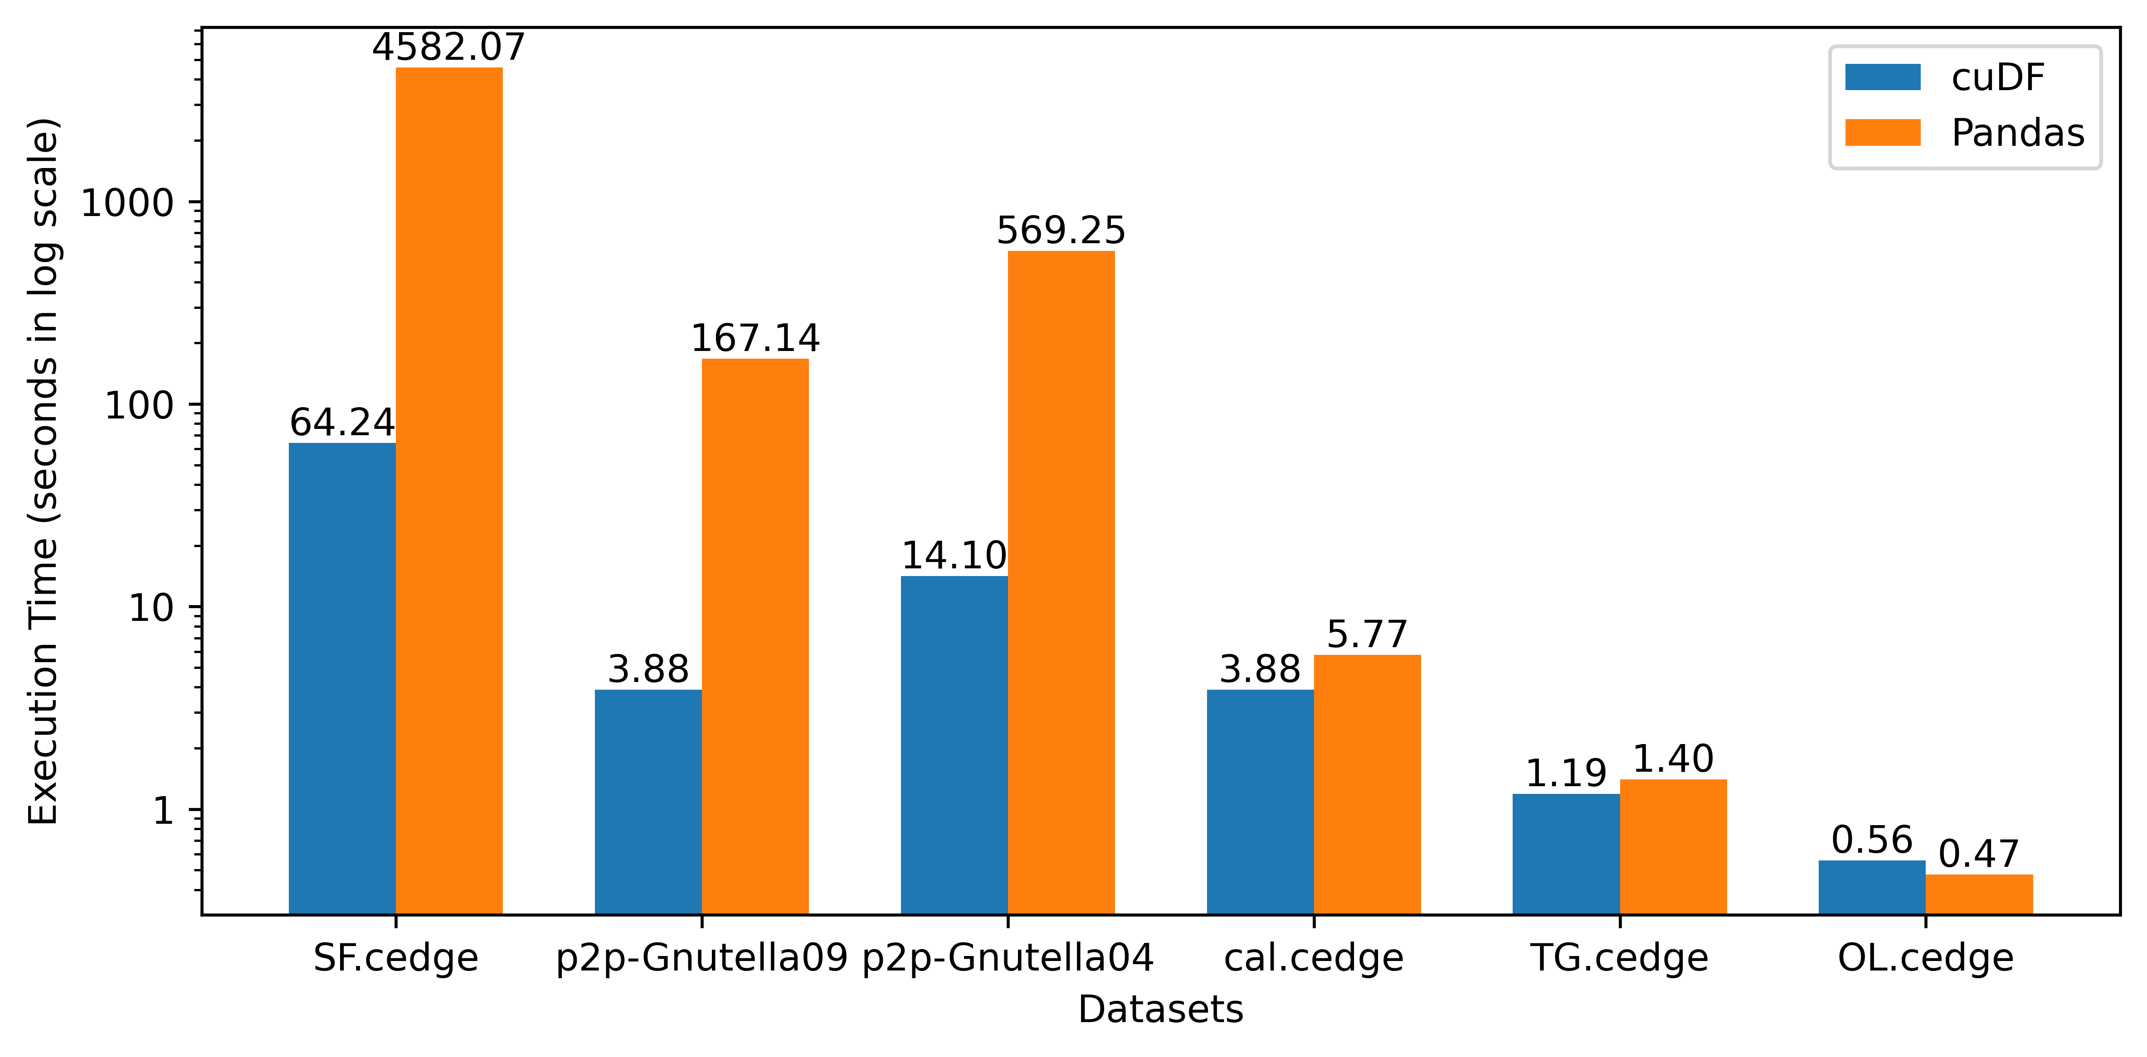
Performance Improvement for cuDF over Pandas (Transitive Closure)
Introduction
Single-GPU Engine: cuDF
Multi-node Multi-GPU
Scientific Analytics
GPU Portability
Power Analysis
Future Work
Conclusion
71x
43x
40x
Shovon, A. R., Dyken, L. R., Green, O., Gilray, T., & Kumar, S. (2022, November). Accelerating datalog applications with cudf. In 2022 IEEE/ACM Workshop on Irregular Applications: Architectures and Algorithms (IA3) (pp. 41-45). IEEE.

Slide 32
Improvement Opportunity
Introduction
Single-GPU Engine: cuDF
Multi-node Multi-GPU
Scientific Analytics
GPU Portability
Power Analysis
Future Work
Conclusion
Open-addressing based hashtable
Fuse join and projection
Sorted results for deduplication
Pinned memory scheme
Intermediate memory clearance
A. R. Shovon, L. R. Dyken, O. Green, T. Gilray and S. Kumar, "Accelerating Datalog applications with cuDF," 2022 IEEE/ACM Workshop on Irregular Applications: Architectures and Algorithms (IA3), Dallas, TX, USA, 2022, pp. 41-45
Green, O., Du, Z., Patel, S., Xie, Z., Liu, H., & Bader, D. A. (2021, December). Anti-Section Transitive Closure. In 2021 IEEE 28th International Conference on High Performance Computing, Data, and Analytics (HiPC) (pp. 192-201). IEEE.

Slide 33
GPU based Datalog engine development
Introduction
Single-GPU Engine: GPUJoin
Multi-node Multi-GPU
Scientific Analytics
GPU Portability
Power Analysis
Future Work
Conclusion
Off-the-shelf
Started with CPU and GPU based Python libraries
Compare GPU capabilities for iterative join operations
GPUJoin
Relational Algebra (RA) operations using CUDA
High performance GPU hashtable for iterative RA
GPULog
CUDA based SIMD API for deductive analytics
Novel Hash-Indexed Sorted Array data structure
Shovon, A. R., Gilray, T., Micinski, K., & Kumar, S. (2023). Towards iterative relational algebra on the {GPU}. In 2023 USENIX Annual Technical Conference (USENIX ATC 23) (pp. 1009-1016).

Slide 34
Hash Table (Open Addressing, Linear Probing)
Introduction
Single-GPU Engine: GPUJoin
Multi-node Multi-GPU
Scientific Analytics
GPU Portability
Power Analysis
Future Work
Conclusion
Grid Stride Loop
0
1
...
511
. . .
Block 0
35
44
11
23
. . .
. . .
0
1
...
511
46
31
. . .
Block n
97
32
CUDA Threads
Key - Value
Hash Table
Key-Value Pair

Slide 35
Hash Table (Open Addressing, Linear Probing)
Introduction
Single-GPU Engine: GPUJoin
Multi-node Multi-GPU
Scientific Analytics
GPU Portability
Power Analysis
Future Work
Conclusion
Grid Stride Loop
Murmur 3 hashing
0
1
...
511
35
44
. . .
Block 0
35
44
11
23
11
23
. . .
. . .
0
1
...
511
AtomicCAS
46
31
. . .
Block n
97
32
CUDA Threads
Key - Value
Hash Table
Key-Value Pair

Slide 36
Hash Table (Open Addressing, Linear Probing)
Introduction
Single-GPU Engine: GPUJoin
Multi-node Multi-GPU
Scientific Analytics
GPU Portability
Power Analysis
Future Work
Conclusion
Grid Stride Loop
Murmur 3 hashing
0
1
...
511
35
44
. . .
Block 0
35
44
11
23
11
23
. . .
. . .
0
1
...
511
AtomicCAS
46
31
. . .
Block n
97
32
CUDA Threads
Key - Value
Hash Table
Key-Value Pair

Slide 37
Hash Table (Open Addressing, Linear Probing)
Introduction
Single-GPU Engine: GPUJoin
Multi-node Multi-GPU
Scientific Analytics
GPU Portability
Power Analysis
Future Work
Conclusion
Grid Stride Loop
Murmur 3 hashing
0
1
...
511
35
44
. . .
Block 0
35
44
11
23
11
23
. . .
. . .
0
1
...
511
AtomicCAS
46
31
. . .
Block n
97
32
CUDA Threads
Key - Value
Hash Table
Key-Value Pair

Slide 38
Hash Table (Open Addressing, Linear Probing)
Introduction
Single-GPU Engine: GPUJoin
Multi-node Multi-GPU
Scientific Analytics
GPU Portability
Power Analysis
Future Work
Conclusion
Grid Stride Loop
Murmur 3 hashing
0
1
...
511
35
44
. . .
Block 0
35
44
11
23
11
23
. . .
. . .
0
1
...
511
AtomicCAS
46
31
. . .
Block n
97
32
Collision -> Linear probing (Position + 1) & hash table size
CUDA Threads
Key - Value
Hash Table
Key-Value Pair

Slide 39
Hash Table (Open Addressing, Linear Probing)
Introduction
Single-GPU Engine: GPUJoin
Multi-node Multi-GPU
Scientific Analytics
GPU Portability
Power Analysis
Future Work
Conclusion
Grid Stride Loop
Murmur 3 hashing
0
1
...
511
35
44
. . .
Block 0
35
44
11
23
11
23
. . .
. . .
0
1
...
511
AtomicCAS
46
31
. . .
Block n
46
31
97
32
Collision -> Linear probing (Position + 1) & hash table size
97
32
CUDA Threads
Key - Value
Hash Table
Key-Value Pair

Slide 40
Hash Table (Open Addressing, Linear Probing)
Introduction
Single-GPU Engine: GPUJoin
Multi-node Multi-GPU
Scientific Analytics
GPU Portability
Power Analysis
Future Work
Conclusion
Stores key-value pairs in sparse space
Uses extra memory
Grid Stride Loop
Murmur 3 hashing
0
1
...
511
35
44
. . .
Block 0
35
44
11
23
11
23
. . .
. . .
0
1
...
511
AtomicCAS
46
31
. . .
Block n
46
31
97
32
Collision -> Linear probing (Position + 1) & hash table size
97
32
CUDA Threads
Key - Value
Hash Table
Key-Value Pair

Slide 41
Hash Table Performance
Introduction
Single-GPU Engine: GPUJoin
Multi-node Multi-GPU
Scientific Analytics
GPU Portability
Power Analysis
Future Work
Conclusion
Build rate:
Random synthetic graph: 400 million keys/second
String graph: 4 billion keys/second
0
1
2
3
4
String graph

Slide 42
Performing Hash Join on GPU
Introduction
Single-GPU Engine: GPUJoin
Multi-node Multi-GPU
Scientific Analytics
GPU Portability
Power Analysis
Future Work
Conclusion
Static Hash Table
Inner Relation
Key | Value
Key | Value
Calculate join size
⨝
First pass

Slide 43
Performing Hash Join on GPU
Introduction
Single-GPU Engine: GPUJoin
Multi-node Multi-GPU
Scientific Analytics
GPU Portability
Power Analysis
Future Work
Conclusion
Static Hash Table
Inner Relation
Key | Value
Key | Value
Calculate join size
⨝
First pass
Prefix sum
Join Result
Second pass
(fused projection)
Join Key | Value 1 | Value 2

Slide 44
Performing Hash Join on GPU
Introduction
Single-GPU Engine: GPUJoin
Multi-node Multi-GPU
Scientific Analytics
GPU Portability
Power Analysis
Future Work
Conclusion
Static Hash Table
Inner Relation
Key | Value
Key | Value
Calculate join size
⨝
First pass
Prefix sum
Join Result
Second pass
(fused projection)
Join Key | Value 1 | Value 2
Sort and Unique
Deduplicated Join Result
Key | Value

Slide 45
Evaluation environment, applications, datasets
Introduction
Single-GPU Engine: GPUJoin
Multi-node Multi-GPU
Scientific Analytics
GPU Portability
Power Analysis
Future Work
Conclusion
Apps: Transitive Closure, Iterated Hash Join
Datasets: Stanford large network, SuiteSparse, Road network
Argonne Leadership Computing Facility. 2022. Theta. https://www.alcf.anl.gov/alcf-resources/theta
Jure Leskovec and Andrej Krevl. 2014. SNAP Datasets: Stanford Large Network Dataset Collection. http://snap.stanford.edu/data
Timothy A. Davis and Yifan Hu. 2011. The University of Florida Sparse Matrix Collection. ACM Trans. Math. Softw. 38, 1, Article 1 (dec 2011), 25 pages. doi:10.1145/2049662.2049663

Slide 46
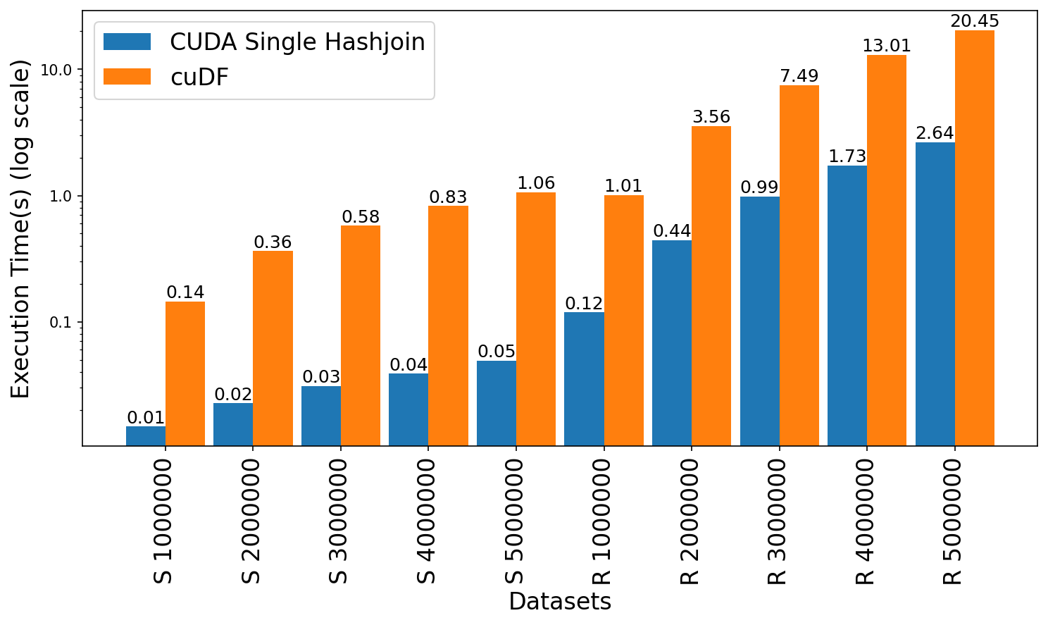
Join Performance Comparison: GPUJoin vs cuDF
Introduction
Single-GPU Engine: GPUJoin
Multi-node Multi-GPU
Scientific Analytics
GPU Portability
Power Analysis
Future Work
Conclusion
21x
8x
7x
Leadership Computing Facility, A. (2022). Argonne Leadership Computing Facility. Theta GPU Nodes. URL: https://www.alcf.anl.gov/support-center/theta-gpu-nodes
Notes:
Observe up to 21x speedup for string graph
Observe 7.6x to 8.4x speedup for random graph

Slide 47
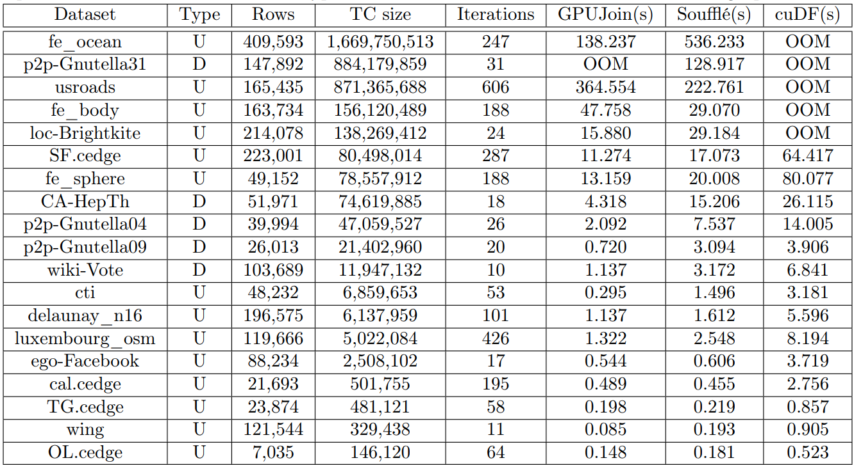
Transitive closure performance evaluation
Introduction
Single-GPU Engine: GPUJoin
Multi-node Multi-GPU
Scientific Analytics
GPU Portability
Power Analysis
Future Work
Conclusion
3.9x
10x
Leadership Computing Facility, A. (2022). Argonne Leadership Computing Facility. Theta GPU Nodes. URL: https://www.alcf.anl.gov/support-center/theta-gpu-nodes
Notes:
Observe up to 21x speedup for string graph
Observe 7.6x to 8.4x speedup for random graph

Slide 48
Fallback: Memory usage
Introduction
Single-GPU Engine: GPUJoin
Multi-node Multi-GPU
Scientific Analytics
GPU Portability
Power Analysis
Future Work
Conclusion

Slide 49
GPU based Datalog engine development
Introduction
Single-GPU Engine: GPULog
Multi-node Multi-GPU
Scientific Analytics
GPU Portability
Power Analysis
Future Work
Conclusion
Off-the-shelf
Started with CPU and GPU based Python libraries
Compare GPU capabilities for iterative join operations
GPUJoin
Relational Algebra (RA) operations using CUDA
High performance GPU hashtable for iterative RA
GPULog
CUDA based SIMD API for deductive analytics
Novel Hash-Indexed Sorted Array data structure
Sun, Y., Shovon, A. R., Gilray, T., Kumar, S., & Micinski, K. (2025, March). Optimizing Datalog for the GPU. In Proceedings of the 30th ACM International Conference on Architectural Support for Programming Languages and Operating Systems, Volume 1 (pp. 762-776).

Slide 50
Hash Indexed Sorted Array (HISA)
Introduction
Single-GPU Engine: GPULog
Multi-node Multi-GPU
Scientific Analytics
GPU Portability
Power Analysis
Future Work
Conclusion
Enable fast lookups
Reduce memory
Grid Stride Loop
Murmur 3 hashing
0
1
...
511
*11
. . .
Block 0
35
44
11
23
*35
35
44
. . .
11
23
. . .
0
1
...
511
AtomicCAS
46
31
46
31
. . .
97
32
Block n
*46
97
32
Collision -> Linear probing (Position + 1) & hash table size
*97
Compact
Data Array
CUDA Threads
Key - Value
Sorted Index Map

Slide 51
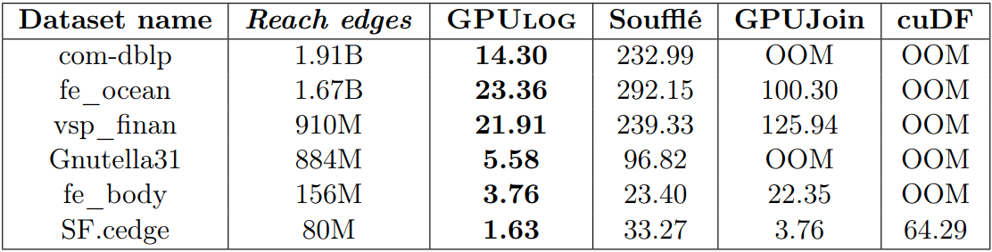
Performance Enhancement (Transitive closure)
Introduction
Single-GPU Engine: GPULog
Multi-node Multi-GPU
Scientific Analytics
GPU Portability
Power Analysis
Future Work
Conclusion
12x to 20x
3x to 6x
39x
Sun, Y., Shovon, A. R., Gilray, T., Micinski, K., & Kumar, S. Optimizing Datalog for the GPU. ASPLOS 2025 (Accepted).

Slide 52

Limitations
Introduction
Single-GPU Engine: GPULog
Multi-node Multi-GPU
Scientific Analytics
GPU Portability
Power Analysis
Future Work
Conclusion
Limited to a single GPU
Memory overflow error for larger graphs

Slide 53
Roadmap
Introduction and motivation
GPU based Datalog engine development
Multi-node multi-GPU Datalog engine development
GPU portability of Datalog engines
Power analysis of Datalog engines
Exploration of high-dimensional scientific analytics
Future work
Conclusion

Slide 54
Multi-node multi-GPU Datalog engine development
Introduction
Single-GPU Engines
Multi-node Multi-GPU Engine: MNMGDatalog
Scientific Analytics
GPU Portability
Power Analysis
Future Work
Conclusion
MNMGDatalog
MPI + X (Cuda) design
Multi-node multi-GPU Datalog engine
3rd Best Poster Award at Computational Research Symposium 2025
Shovon, A. R., Sun, Y., Gilray, T., Micinski, K., & Kumar, S. (2025). Multi-Node Multi-GPU Datalog, ICS 2025.

Slide 55
Requirements for Multi-node Multi-GPU Datalog
Introduction
Single-GPU Engines
Multi-node Multi-GPU Engine: MNMGDatalog
Scientific Analytics
GPU Portability
Power Analysis
Future Work
Conclusion
1
G
1
T
tc(X, Y) :- edges(X, Y).
tc(X, Z) :- tc(X, Y), edges(Y, Z).
0
3
4
0
3
4
Data representation
2
2
2
0​ | 1​
0 | 2​
1​ | 3​
2​ | 3​
3 | 4
0​ | 1​
0​ | 2​
1​ | 3​
2​ | 3​
3​ | 4​
0​ | 3​
1​ | 4​
2​ | 4​
0​ | 4​
Communication
Workload partitioning
3
1

Slide 56
MNMGDatalog Implementation
Introduction
Single-GPU Engines
Multi-node Multi-GPU Engine: MNMGDatalog
Scientific Analytics
GPU Portability
Power Analysis
Future Work
Conclusion
Hash-based data distribution
GPU-optimized data representation
GPU-Aware all-to-all communication
Workload partitioning
Data representation
Communication
1
2
3

Slide 57
MNMGDatalog: Radix-hash-based partitioning
Introduction
Single-GPU Engines
Multi-node Multi-GPU Engine: MNMGDatalog
Scientific Analytics
GPU Portability
Power Analysis
Future Work
Conclusion
Hash-based data distribution
GPU-optimized data representation
GPU-Aware all-to-all communication
Workload partitioning
Data representation
Communication
1
2
3

Slide 58
(k)
The join column decides the GPU (bucket-id)
0 | 1
0 | 2
0 | 3
1 | 2
1 | 3
1 | 4
2 | 4
3 | 4
3 | 6
4 | 5
4 | 6
5 | 7
5 | 9
7 | 6
7 | 8
8 | 9
5
2
0
1
4
7
8
9
3
6
Hash-partitioning based on the
Join Column
Kumar, S., & Gilray, T. (2020). Load-balancing parallel relational algebra. In High Performance Computing: 35th International Conference, ISC High Performance 2020, Frankfurt/Main, Germany, June 22–25, 2020, Proceedings 35 (pp. 288-308). Springer International Publishing.
Notes:
In a join, it is necessary to iterate over all tuples where particular columns match a value or values taken from the ﬁrst operand of join—in which case the variable being matched should come ﬁrst and be a key in the outermost B-tree. The relation is thus explicitly indexed on this column.

Slide 59
(k)
0 | 1
0 | 2
0 | 3
0
1
2
The join column decides the GPU (bucket-id)
0 | 1
0 | 2
0 | 3
1 | 2
1 | 3
1 | 4
2 | 4
3 | 4
3 | 6
4 | 5
4 | 6
5 | 7
5 | 9
7 | 6
7 | 8
8 | 9
0 | 1
0 | 2
0 | 3
1 | 2
1 | 3
1 | 4
2 | 4
3 | 4
3 | 6
4 | 5
4 | 6
5 | 7
5 | 9
7 | 6
7 | 8
8 | 9
3 | 4
3 | 6
7 | 6
7 | 8
5
2
5 | 7
5 | 9
8 | 9
Hash(k) % 3
0
1
4
7
8
9
3
1 | 2
1 | 3
1 | 4
6
GPU (ID)
2 | 4
4 | 5
4 | 6
Kumar, S., & Gilray, T. (2020). Load-balancing parallel relational algebra. In High Performance Computing: 35th International Conference, ISC High Performance 2020, Frankfurt/Main, Germany, June 22–25, 2020, Proceedings 35 (pp. 288-308). Springer International Publishing.
Notes:
In a join, it is necessary to iterate over all tuples where particular columns match a value or values taken from the ﬁrst operand of join—in which case the variable being matched should come ﬁrst and be a key in the outermost B-tree. The relation is thus explicitly indexed on this column.

Slide 60
MNMGDatalog: Data representation
Introduction
Single-GPU Engines
Multi-node Multi-GPU Engine: MNMGDatalog
Scientific Analytics
GPU Portability
Power Analysis
Future Work
Conclusion
Hash-based data distribution
GPU-optimized data representation
GPU-Aware all-to-all communication
Workload partitioning
Data representation
Communication
1
2
3

Slide 61
GPU Hash Table (Open Addressing, Linear Probing)
Introduction
Single-GPU Engines
Multi-node Multi-GPU Engine: MNMGDatalog
Scientific Analytics
GPU Portability
Power Analysis
Future Work
Conclusion
Grid Stride Loop
Murmur 3 hashing
0
1
...
511
35
44
. . .
Block 0
35
44
11
23
11
23
. . .
. . .
0
1
...
511
AtomicCAS
46
31
. . .
Block n
46
31
97
32
Collision -> Linear probing (Position + 1) & hash table size
97
32
CUDA Threads
Key - Value
Hash Table
Key-Value Pair
Shovon, A. R., Gilray, T., Micinski, K., & Kumar, S. (2023). Towards iterative relational algebra on the {GPU}. In 2023 USENIX Annual Technical Conference (USENIX ATC 23) (pp. 1009-1016).

Slide 62
MNMGDatalog: Communication for Iterative RA
Introduction
Single-GPU Engines
Multi-node Multi-GPU Engine: MNMGDatalog
Scientific Analytics
GPU Portability
Power Analysis
Future Work
Conclusion
Hash-based data distribution
GPU-optimized data representation
GPU-Aware all-to-all communication
Workload partitioning
Data representation
Communication
1
2
3

Slide 63
Relational Algebra Kernel
All to all comm
Join Project Hash
GPU 0
GPU 1
GPU 2
GPU 3
GPU 4
Kumar, S., & Gilray, T. (2020). Load-balancing parallel relational algebra. In High Performance Computing: 35th International Conference, ISC High Performance 2020, Frankfurt/Main, Germany, June 22–25, 2020, Proceedings 35 (pp. 288-308). Springer International Publishing.

Slide 64
Relational Algebra Kernel
All to all comm
Local inserts
Join Project Hash
GPU 0
GPU 1
GPU 2
GPU 3
GPU 4

Slide 65
Fixed point?
Relational Algebra Kernel
All to all comm
Local inserts
Join Project Hash
GPU 0
GPU 1
GPU 2
GPU 3
GPU 4

Slide 66
NO
Fixed point?
Relational Algebra Kernel
All to all comm
Local inserts
Join Project Hash
GPU 0
GPU 1
GPU 2
GPU 3
GPU 4

Slide 67
NO
Fixed point?
YES
Relational Algebra Kernel
All to all comm
Local inserts
STOP
Join Project Hash
GPU 0
GPU 1
GPU 2
GPU 3
GPU 4

Slide 68
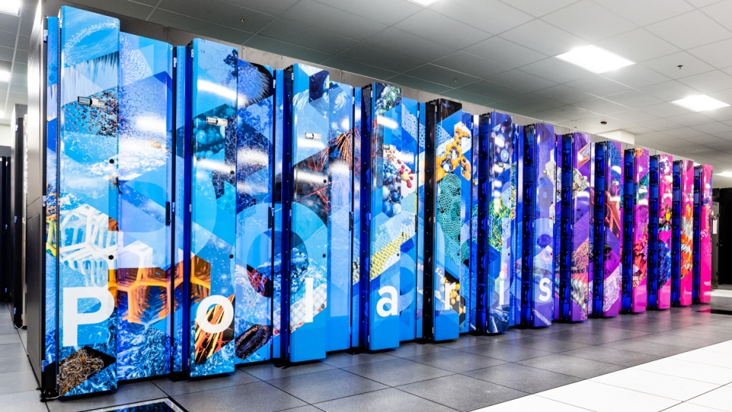
MNMGDatalog Evaluation
Introduction
Single-GPU Engines
Multi-node Multi-GPU Engine: MNMGDatalog
Scientific Analytics
GPU Portability
Power Analysis
Future Work
Conclusion
Multi-threaded
Multi-node
Multi-threaded
Single-GPU
Soufflé
SLOG
GPUJoin
Polaris (Argonne National Lab)
GPULog
cuDF
Argonne Leadership Computing Facility. 2022. Polaris. https://www.alcf.anl.gov/polaris
Jure Leskovec and Andrej Krevl. 2014. SNAP Datasets: Stanford Large Network Dataset Collection. http://snap.stanford.edu/data
Timothy A. Davis and Yifan Hu. 2011. The University of Florida Sparse Matrix Collection. ACM Trans. Math. Softw. 38, 1, Article 1 (dec 2011), 25 pages. doi:10.1145/2049662.2049663

Slide 69
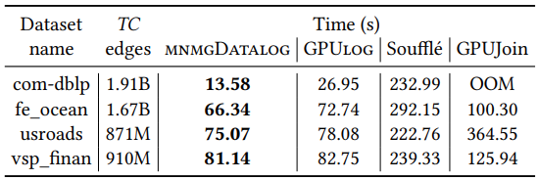
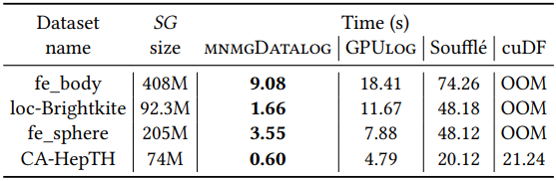
Single GPU benchmark
Introduction
Single-GPU Engines
Multi-node Multi-GPU Engine: MNMGDatalog
Scientific Analytics
GPU Portability
Power Analysis
Future Work
Conclusion
Transitive closure benchmark on single-GPU
Same generation benchmark on single-GPU
Speedup up to 1.9x over GPULog, 20x over Souffle, 4.8x over GPUJoin
Speedup up to 7x over GPULog, 33.5x over Souffle, 35.4x over cuDF

Slide 70
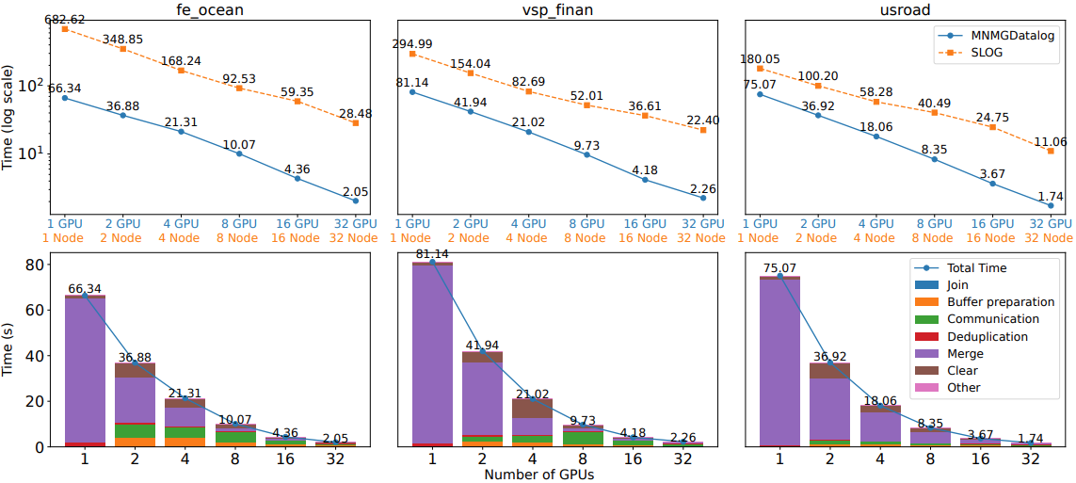
Multi-node multi-GPU benchmark
Introduction
Single-GPU Engines
Multi-node Multi-GPU Engine: MNMGDatalog
Scientific Analytics
GPU Portability
Power Analysis
Future Work
Conclusion
Transitive closure benchmark and breakdown up to 32 GPUs
Speedup up to 32x

Slide 71
Roadmap
Introduction and motivation
GPU based Datalog engine development
Multi-node multi-GPU Datalog engine development
GPU portability of Datalog engines
Power analysis of Datalog engines
Exploration of high-dimensional scientific analytics
Future work
Conclusion

Slide 72


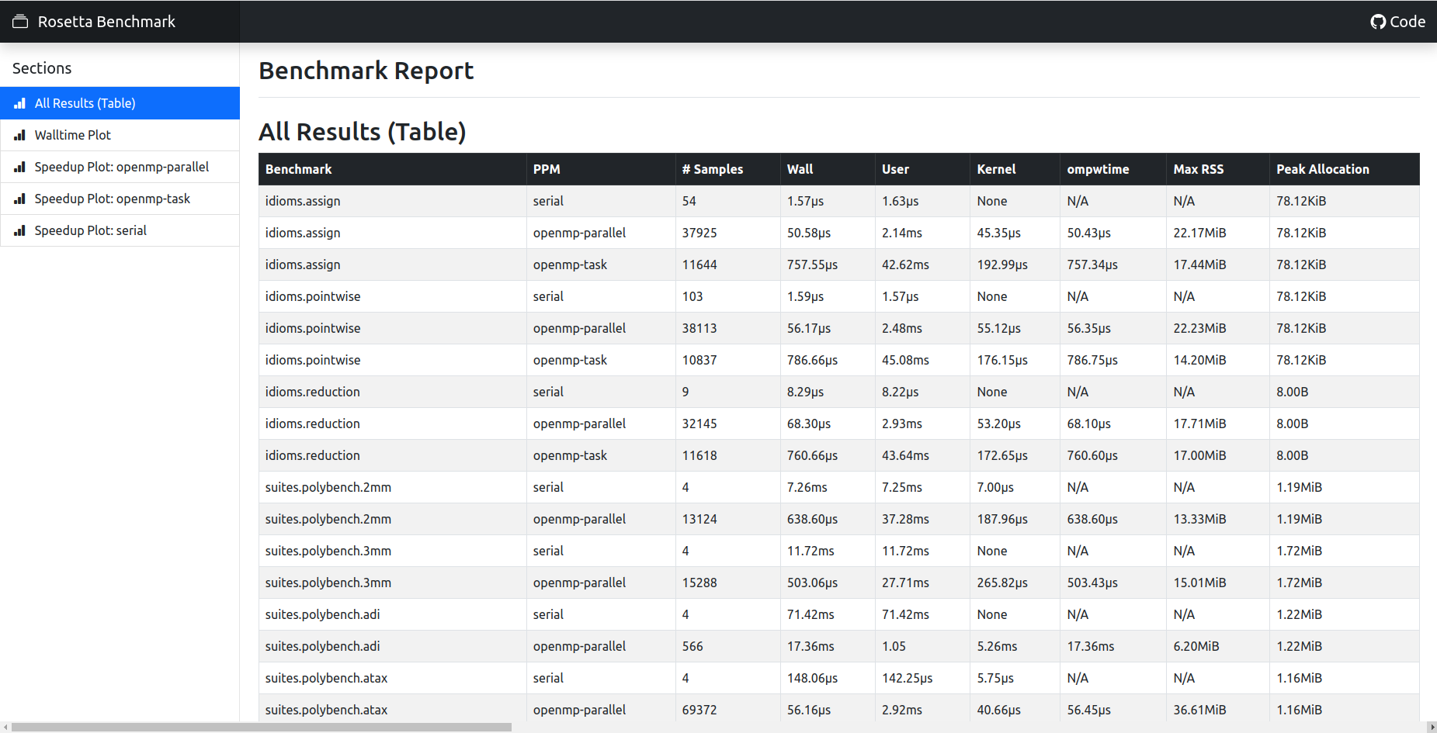
Parallel Programming Models
Introduction
Single-GPU Engines
Multi-node Multi-GPU
Scientific Analytics
GPU Portability
Power Analysis
Future Work
Conclusion
Rosetta parallel programming models benchmarking framework
Sequential
OpenMP
OpenMP-target
CUDA
HIP
SYCL
Rosetta-bench Github repository. https://github.com/Meinersbur/rosetta

Slide 73
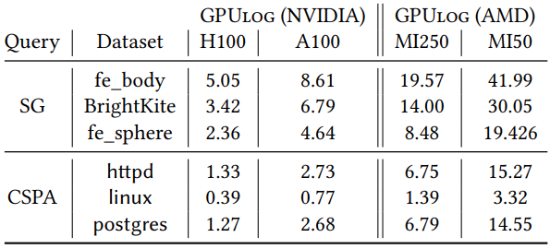
GPULog-HIP
Introduction
Single-GPU Engines
Multi-node Multi-GPU
Scientific Analytics
GPU Portability
Power Analysis
Future Work
Conclusion
Ported GPULog to GPULog-HIP
AMD MI250 (dual chiplet) ≈ Nvidia A100
GPULog-HIP uses only one MI250 chiplet
GPULog benefits from Nvidia RMM library
GPULog and GPULog-HIP comparison on Nvidia and AMD GPUs
GPULog-HIP Github repository. https://github.com/harp-lab/gdlog-hip

Slide 74

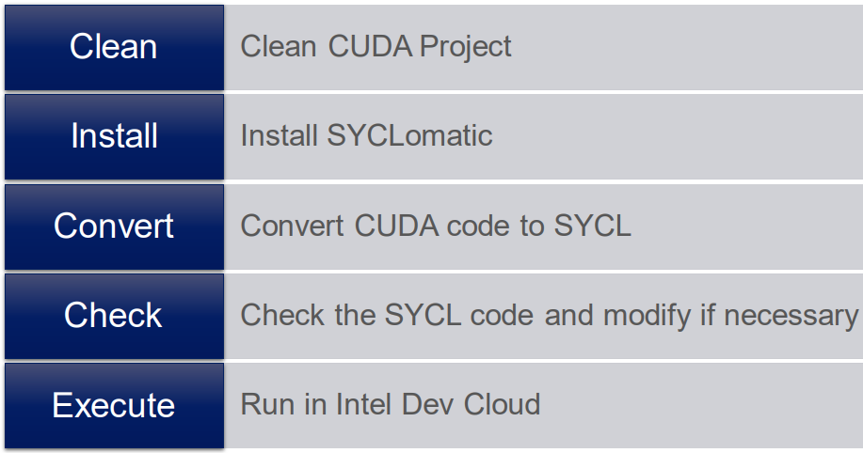
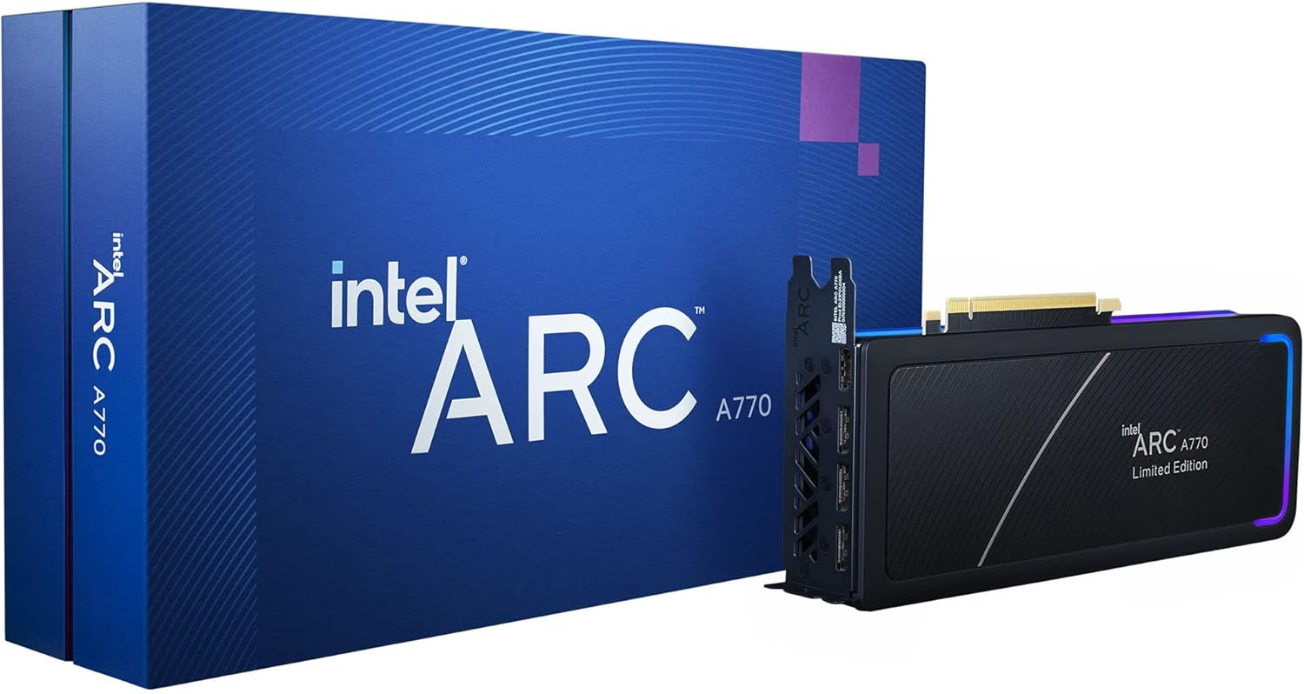
GPUJoin-SYCL
Introduction
Single-GPU Engines
Multi-node Multi-GPU
Scientific Analytics
GPU Portability
Power Analysis
Future Work
Conclusion
Ported GPUJoin to SYCL using SYCLomatic
Required bug fixing of the generated code
Scratch implementation of TC using SYCL
Won Intel® Arc A770 Limited Edition GPU
CUDA-based GPUJoin to SYCL using SYCLomatic
oneAPI Hackathon: CUDA to SYCL Migration https://oneapi-sycl-hackathon.devpost.com/
Github repository: https://github.com/arsho/tc

Slide 75
Roadmap
Introduction and motivation
GPU based Datalog engine development
Multi-node multi-GPU Datalog engine development
GPU portability of Datalog engines
Power analysis of Datalog engines
Exploration of high-dimensional scientific analytics
Future work
Conclusion

Slide 76
Compare energy profiles across Datalog engines
Introduction
Single-GPU Engines
Multi-node Multi-GPU
Scientific Analytics
GPU Portability
Power Analysis
Future Work
Conclusion
Engine | Join strategy | Data structure
MNMGDatalog | Radix hash join | GPU Hash table
INLJoin | Index nested loop join | GPU struct array
GPULog | Sorted hash join | Hash-Indexed Sorted Array
BJoin | Batch join with memory pooling | Hash-Indexed Sorted Array
cuDF | Dataframe’s merge | Python’s Dataframe
Polaris (Argonne National Lab)
Tools: nvidia-smi, nvml, NVIDIA Nsight systems, NVIDIA Nsight compute

Slide 77
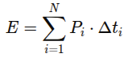
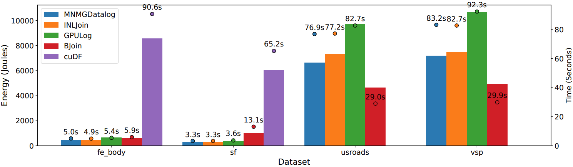
Energy profile: TC energy consumption (single-GPU)
Introduction
Single-GPU Engines
Multi-node Multi-GPU
Scientific Analytics
GPU Portability
Power Analysis
Future Work
Conclusion
N is the total number of sampling intervals
P_{i​} is the power draw (in watts) measured at interval i
Δt_{i} is the time (in seconds) between samples i and i - 1

Slide 78
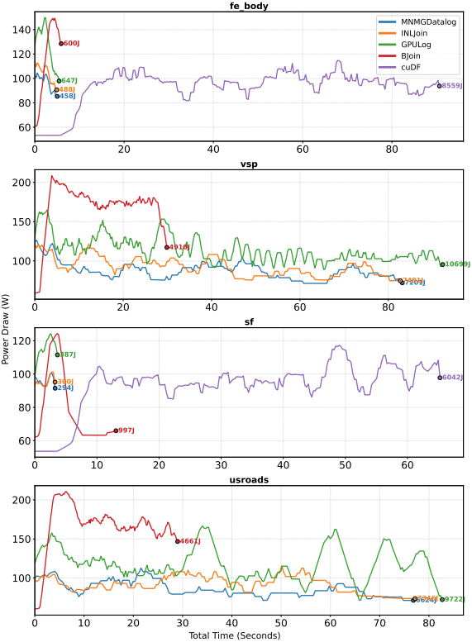
BJoin’s memory pooling draws more power, runs faster for larger iterations
HISA-based joins (BJoin, GPULog) use more energy
Simpler GPU friendly data structure (MNMGDatalog and INLJoin) draws less power but could run longer
Power draw (TC)

Slide 79
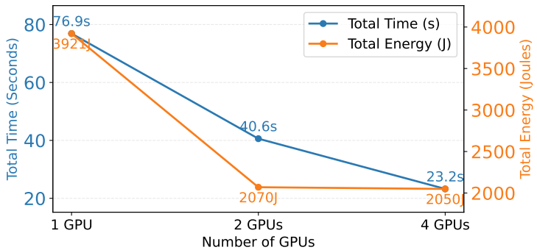
Energy profile: TC energy consumption (multi-GPUs)
Introduction
Single-GPU Engines
Multi-node Multi-GPU
Scientific Analytics
GPU Portability
Power Analysis
Future Work
Conclusion
TC energy consumption (1 - 4 GPUs) for usroads dataset using MNMGDatalog

Slide 80
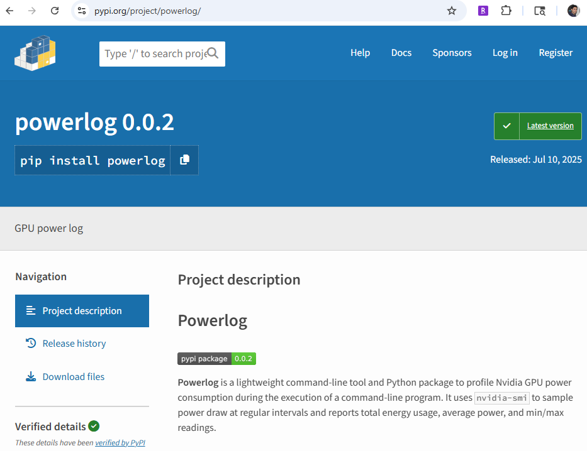
Powerlog CLI Tool for Energy Profiling GPU Applications
Introduction
Single-GPU Engines
Multi-node Multi-GPU
Scientific Analytics
GPU Portability
Power Analysis
Future Work
Conclusion
Powerlog Python package (https://pypi.org/project/powerlog/)

Slide 81
Roadmap
Introduction and motivation
GPU based Datalog engine development
Multi-node multi-GPU Datalog engine development
GPU portability of Datalog engines
Power analysis of Datalog engines
Exploration of high-dimensional scientific analytics
Future work
Conclusion

Slide 82
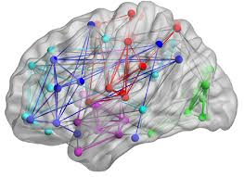
What is a brain network?
Introduction
Single-GPU Engines
Multi-node Multi-GPU
Scientific Analytics
GPU Portability
Power Analysis
Future Work
Conclusion
Notes:
A brain network is a system of interconnected brain regions that communicate with each other to perform various cognitive, sensory, or motor functions.

Slide 83
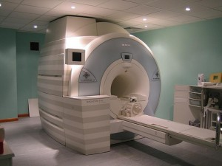
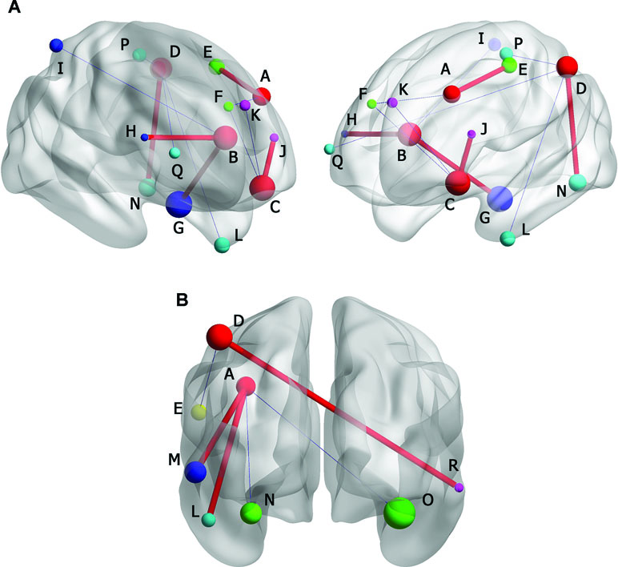
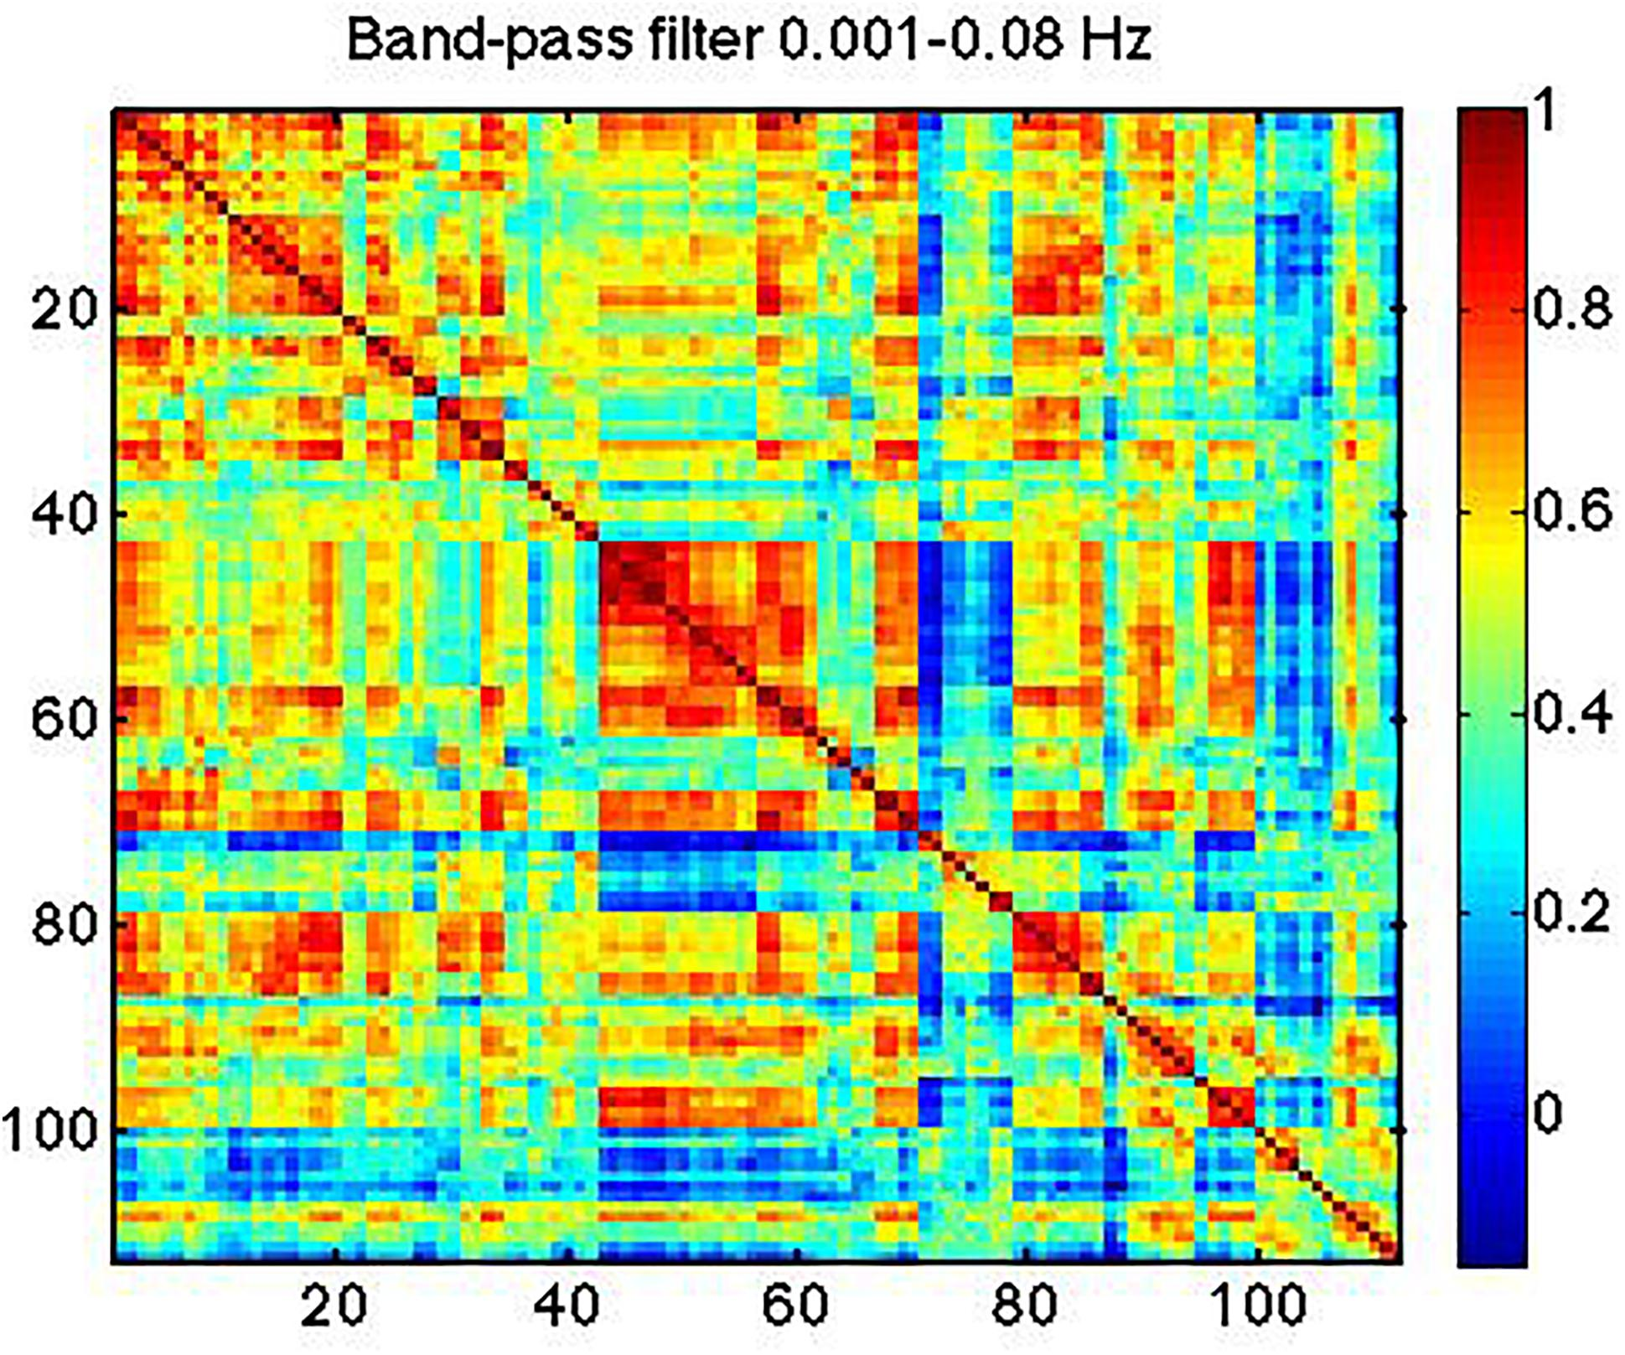
How to construct brain network?
Introduction
Single-GPU Engines
Multi-node Multi-GPU
Scientific Analytics
GPU Portability
Power Analysis
Future Work
Conclusion
Notes:
MRI scanner captures brain activity. resting-state functional magnetic resonance imaging (fMRI)
Fmri images show the connection strength between various regions, representing how these areas communicate with each other.
In FCN the colors indicate the strength of connections between different brain regions

Slide 84
How to construct brain network?
Introduction
Single-GPU Engines
Multi-node Multi-GPU
Scientific Analytics
GPU Portability
Power Analysis
Future Work
Conclusion
Notes:
a brain network refers to a set of interconnected regions in the brain that work together to perform specific functions.
MRI scanner captures brain activity. Fmri images show the connection strength between various regions, representing how these areas communicate with each other.
In FCN the colors indicate the strength of connections between different brain regions

Slide 85
How to construct brain network?
Introduction
Single-GPU Engines
Multi-node Multi-GPU
Scientific Analytics
GPU Portability
Power Analysis
Future Work
Conclusion
Notes:
a brain network refers to a set of interconnected regions in the brain that work together to perform specific functions.
MRI scanner captures brain activity
different parts of the brain are connected to each other, the signal in one part triggers something in other parts which is the edge of the FCN
and this FCN are important biomarkers for catching a lot of diseases
how the connectivity of the brain is depends on a lot of conditions (diseases)

Slide 86

Multi-site brain image analysis
Introduction
Single-GPU Engines
Multi-node Multi-GPU
Scientific Analytics
GPU Portability
Power Analysis
Future Work
Conclusion
Multi-site rs-fMRI studies allow gathering
larger sample sizes
B. B. Biswal, M. Mennes, X.-N. Zuo, S. Gohel, C. Kelly, S. M. Smith, C. F. Beckmann, J. S. Adelstein, R. L. Buckner, S. Colcombe et al., “Toward discovery science of human brain function,” Proceedings of the national academy of sciences, vol. 107, no. 10, pp. 4734–4739, 2010.

Slide 87
Multi-site brain image analysis (continue)
Introduction
Single-GPU Engines
Multi-node Multi-GPU
Scientific Analytics
GPU Portability
Power Analysis
Future Work
Conclusion
But different scanners and sampling periods
negates the advantages of larger sample sizes
C. Dansereau, Y. Benhajali, C. Risterucci, E. M. Pich, P. Orban, D. Arnold, and P. Bellec, “Statistical power and prediction accuracy in multisite resting-state fmri connectivity,” Neuroimage, vol. 149, pp. 220–232, 2017.

Slide 88
Convert fMRI image to FCN
Apply Topological Data Analysis on FCN

Slide 89
Topological Data Analysis (TDA)
Introduction
Single-GPU Engines
Multi-node Multi-GPU
Scientific Analytics
GPU Portability
Power Analysis
Future Work
Conclusion
Main tool: persistent homology, adapts homology to point cloud
Analyzes social networks, brain connectivity, internet
Studies shape of data like connected components, loops, voids
M. Rubinov and O. Sporns, “Complex network measures of brain connectivity: uses and interpretations,” Neuroimage, vol. 52, no. 3, pp. 1059–1069, 2010.
Aktas, M.E., Akbas, E. & Fatmaoui, A.E. Persistence homology of networks: methods and applications. Appl Netw Sci 4, 61 (2019). https://doi.org/10.1007/s41109-019-0179-3

Slide 90
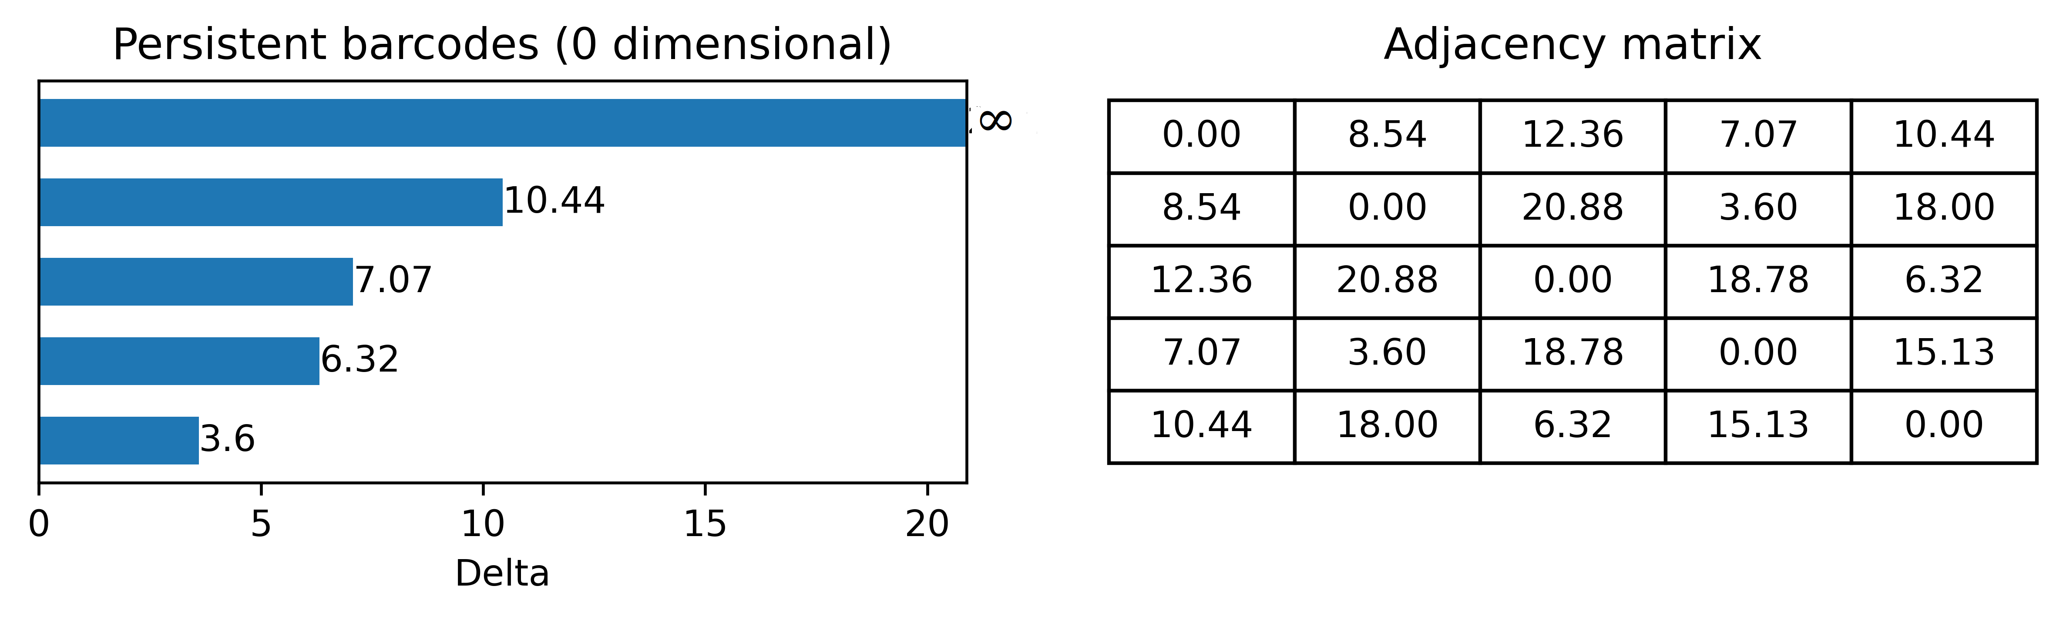
Persistent Barcodes using Connected Component
Introduction
Single-GPU Engines
Multi-node Multi-GPU
Scientific Analytics
GPU Portability
Power Analysis
Future Work
Conclusion
Persistent Homology tracks birth and death of topological features in the graph
0-dim barcodes: each bar shows when each features (connected component) born and die
Kumar, S., Shovon, A. R., & Deshpande, G. (2023). The robustness of persistent homology of brain networks to data acquisition‐related non‐neural variability in resting state fMRI. Human Brain Mapping, 44(13), 4637-4651.

Slide 91
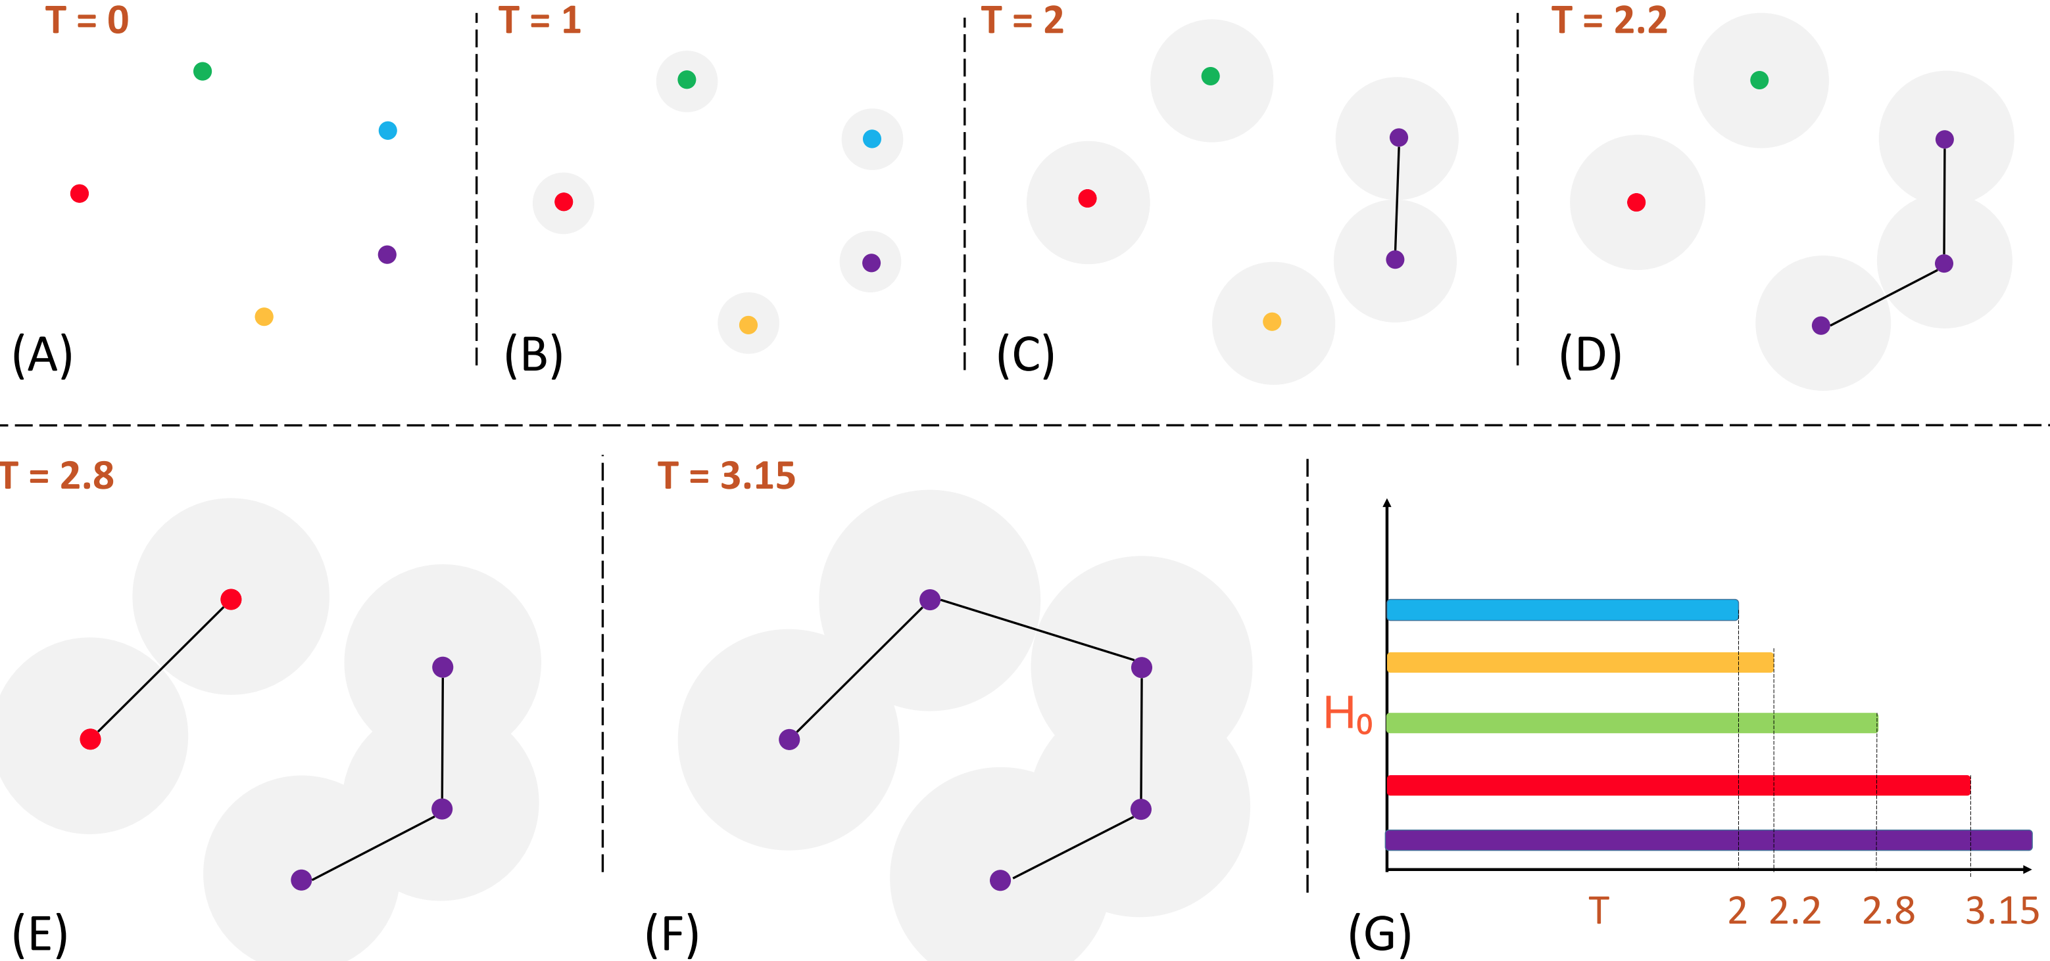
Computing Persistent Homology (Point Cloud)
Introduction
Single-GPU Engines
Multi-node Multi-GPU
Scientific Analytics
GPU Portability
Power Analysis
Future Work
Conclusion

Slide 92
Computing Persistent Homology (Point Cloud)
Introduction
Single-GPU Engines
Multi-node Multi-GPU
Scientific Analytics
GPU Portability
Power Analysis
Future Work
Conclusion

Slide 93
Computing Persistent Homology (Point Cloud)
Introduction
Single-GPU Engines
Multi-node Multi-GPU
Scientific Analytics
GPU Portability
Power Analysis
Future Work
Conclusion

Slide 94
Computing Persistent Homology (Point Cloud)
Introduction
Single-GPU Engines
Multi-node Multi-GPU
Scientific Analytics
GPU Portability
Power Analysis
Future Work
Conclusion

Slide 95
Computing Persistent Homology (Point Cloud)
Introduction
Single-GPU Engines
Multi-node Multi-GPU
Scientific Analytics
GPU Portability
Power Analysis
Future Work
Conclusion

Slide 96
Computing Persistent Homology (Point Cloud)
Introduction
Single-GPU Engines
Multi-node Multi-GPU
Scientific Analytics
GPU Portability
Power Analysis
Future Work
Conclusion

Slide 97
PH for High-Dimensional Data Analysis
Introduction
Single-GPU Engines
Multi-node Multi-GPU
Scientific Analytics
GPU Portability
Power Analysis
Future Work
Conclusion
Verify
PH of rs-fMRI can represent topological features of FCNs
Demonstrate
FCN networks are statistically similar despite variations in TRs
Remove
Non-neural variability in multi-site brain networks
Ashley Suh, Mustafa Hajij, Bei Wang, Carlos Scheidegger, and Paul Rosen. Persistent homologyguided force-directed graph layouts. IEEE Transactions on Visualization and Computer Graphics,26(1):697–707, January 2020
Tananun Songdechakraiwut, Li Shen, and Moo Chung. Topological learning and its application tomultimodal brain network integration. In Medical Image Computing and Computer Assisted Intervention–MICCAI 2021: 24th International Conference, Strasbourg, France, September 27–October 1, 2021,Proceedings, Part II 24, pages 166–176. Springer, 2021.

Slide 98

Limitations
Imperative and complex high-dimensional data analysis pipelines

Slide 99
Declarative Topological Data Analysis
Introduction
Single-GPU Engines
Multi-node Multi-GPU
Scientific Analytics
GPU Portability
Power Analysis
Future Work
Conclusion
Use Datalog to simplify persistent barcodes computations
1
Explore potential applications of using declarative TDA
2
Scale TDA methods to large datasets in HPC environment
3

Slide 100
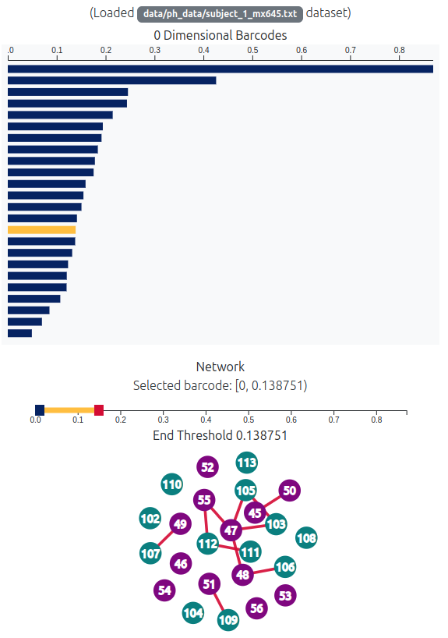
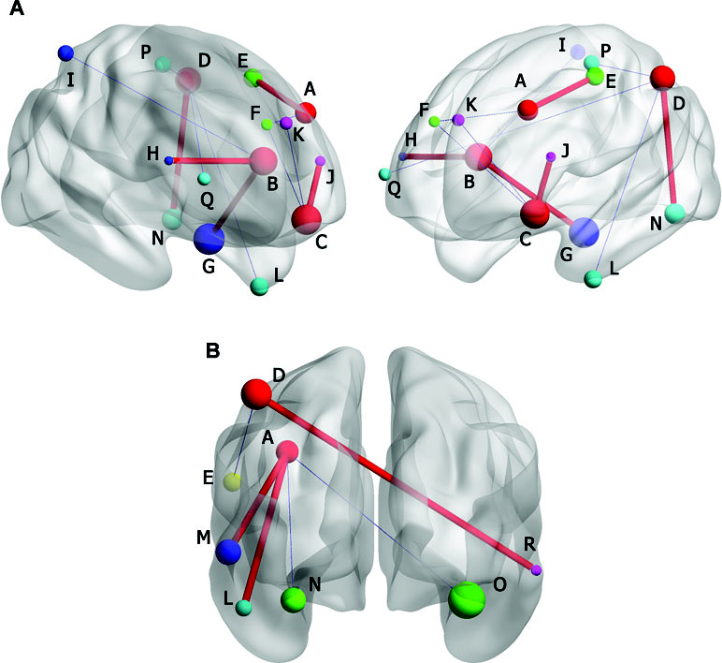
Persistent Barcodes using Declarative Analytics
Introduction
Single-GPU Engines
Multi-node Multi-GPU
Scientific Analytics
GPU Portability
Power Analysis
Future Work
Conclusion
Construct a filtration
Compute persistence of connected components at each threshold
Build graph based on the selected threshold
Web URL: https://harp-lab.github.io/TDA/

Slide 101
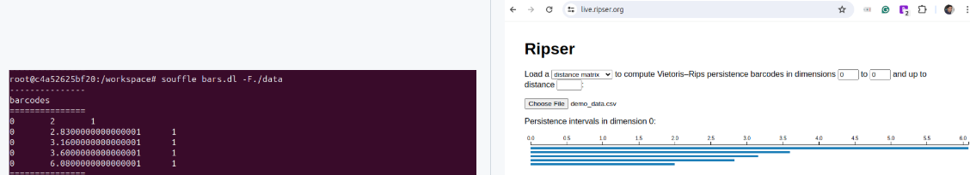

Persistent Barcodes using Declarative Analytics
Introduction
Single-GPU Engines
Multi-node Multi-GPU
Scientific Analytics
GPU Portability
Power Analysis
Future Work
Conclusion
Use Datalog for efficient connected components calculation
Successfully implemented 0-dimensional barcodes using Soufflé
Extend barcodes computation to the SLOG engine for scalable multi-node HPC environments
Thomas Gilray, Arash Sahebolamri, Yihao Sun, Sowmith Kunapaneni, Sidharth Kumar, and Kristopher Micinski. 2024. Datalog with First-Class Facts. Proc. VLDB Endow. 18, 3 (November 2024), 651–665.

Slide 102
Roadmap
Introduction and motivation
GPU based Datalog engine development
Multi-node multi-GPU Datalog engine development
GPU portability of Datalog engines
Power analysis of Datalog engines
Exploration of high-dimensional scientific analytics
Future work
Conclusion

Slide 103
Future/ongoing work
Introduction
Single-GPU Engines
Multi-node Multi-GPU
Scientific Analytics
GPU Portability
Power Analysis
Future Work
Conclusion
Enhance MNMGDatalog implementation
Extend declarative applications
Balance energy and performance

Slide 104
Enhance MNMGDatalog Implementation
Introduction
Single-GPU Engines
Multi-node Multi-GPU
Scientific Analytics
GPU Portability
Power Analysis
Future Work
Conclusion
Add per-iteration checkpoint/restart capability
Develop HIP and SYCL version for MNMGDatalog

Slide 105
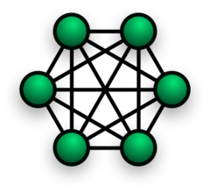
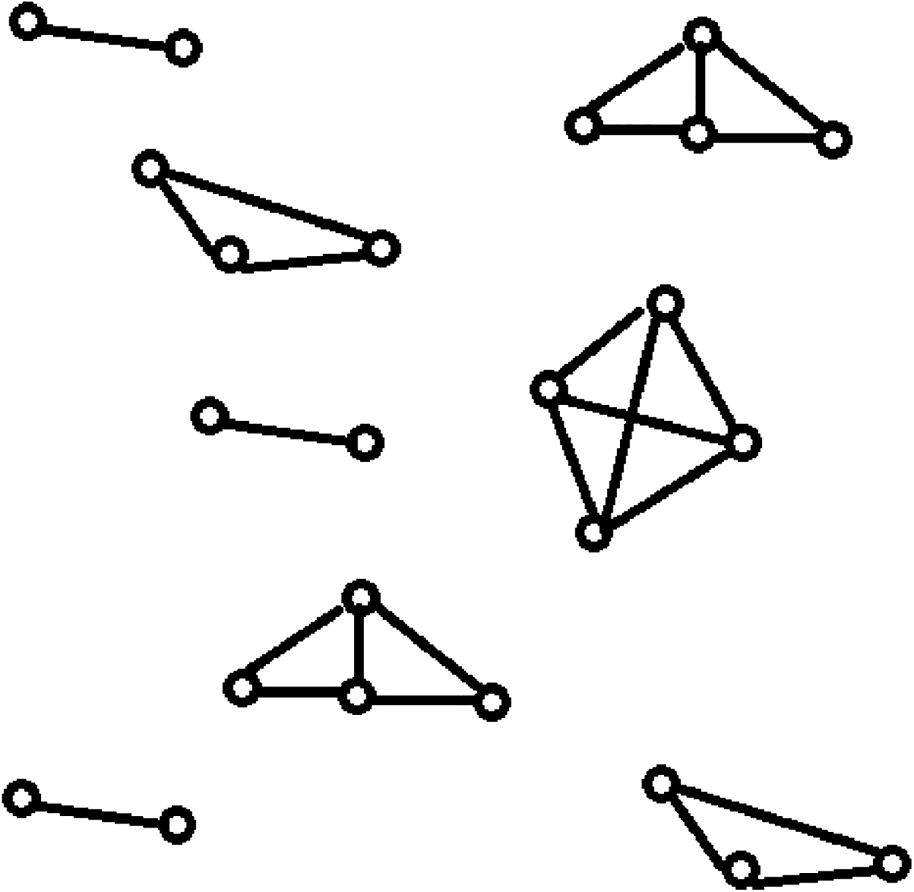
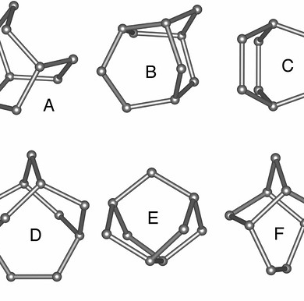
MNMGDatalog for High-dimensional Brain Imaging
Introduction
Single-GPU Engines
Multi-node Multi-GPU
Scientific Analytics
GPU Portability
Power Analysis
Future Work
Conclusion
MNMGDatalog for fully connected network
Declarative modeling of topological structure
Topological pattern matching
Use high-level expressive query to handle dense connectivity graphs from brain imaging data
Encode high-dimensional relationships using recursive rules over pairwise similarities
Discover persistent structural motifs across subjects using distributed recursive evaluation

Slide 106
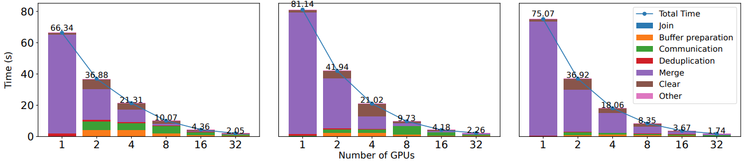
Power-aware Declarative Analytics
Introduction
Single-GPU Engines
Multi-node Multi-GPU
Scientific Analytics
GPU Portability
Power Analysis
Future Work
Conclusion
Compare energy profiles across Datalog engines
Design runtime tools to correlate iterative operations with power draw
Develop AI-driven models to optimize query plans for energy efficiency

Slide 107
Roadmap
Introduction and motivation
GPU based Datalog engine development
Multi-node multi-GPU Datalog engine development
GPU portability of Datalog engines
Power analysis of Datalog engines
Exploration of high-dimensional scientific analytics
Future work
Conclusion

Slide 108
Conclusion
Introduction
Single-GPU Engines
Multi-node Multi-GPU
Scientific Analytics
GPU Portability
Power Analysis
Future Work
Conclusion
Declarative analytics at scale
Single-GPU
Multi-GPU
GPUJoin
GPULog
MNMGDatalog
GPU Portability and power analysis
Portability
Power analysis
GPUJoin-SYCL
GPULog-HIP
Powerlog
Scientific analytics
Topological data analysis
Declarative TDA

Slide 109




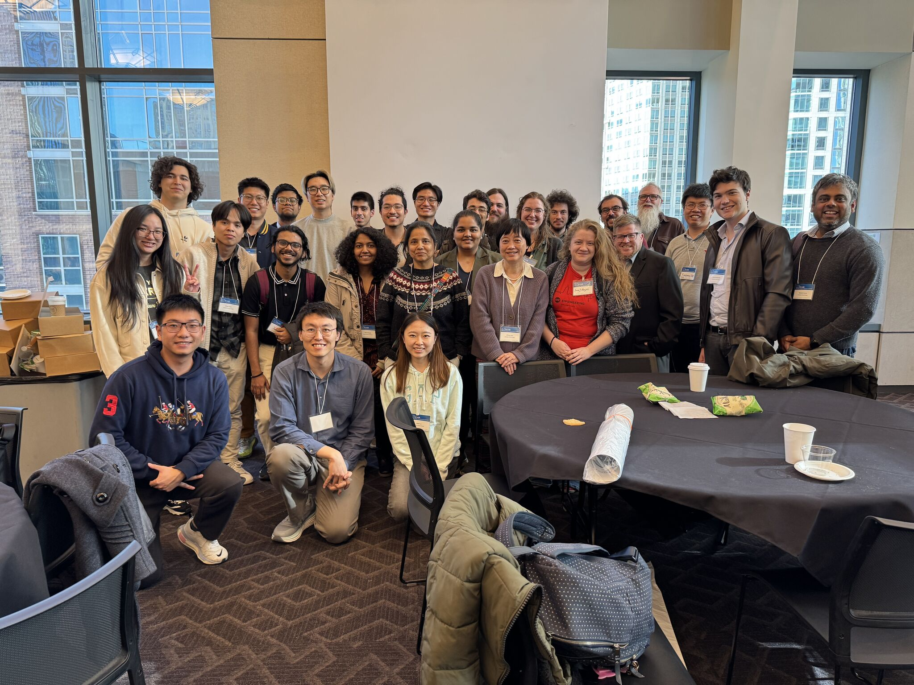





Acknowledgements

Slide 110

Thank You
ashov@uic.edu
https://arshovon.com/
https://github.com/harp-lab/MNMGDatalog

Slide 111
Appendix

Slide 112
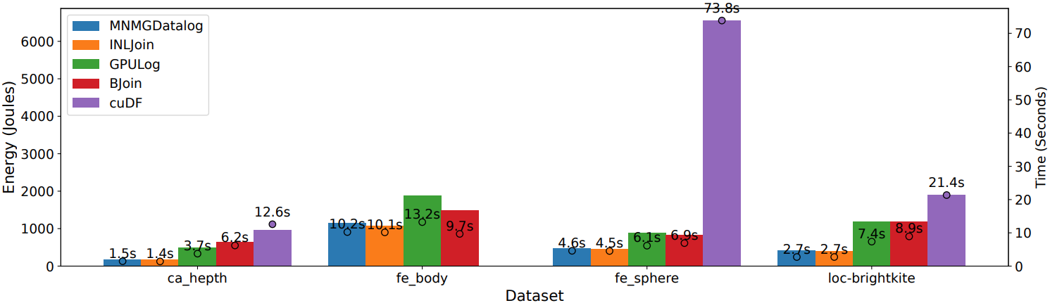
Energy profile: SG energy consumption (single-GPU)
N is the total number of sampling intervals
P_{i​} is the power draw (in watts) measured at interval i
Δt_{i} is the time (in seconds) between samples i and i - 1

Slide 113
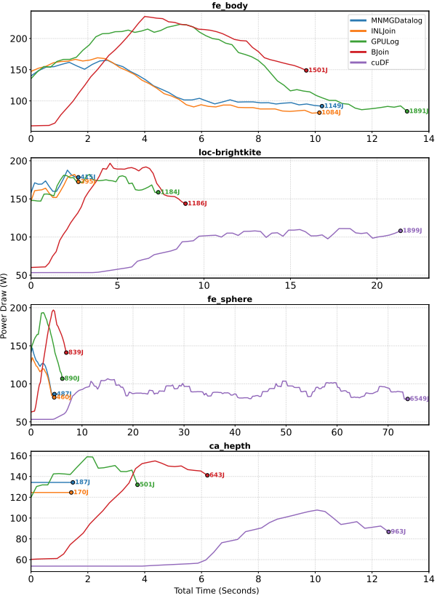
Power draw (SG)

Slide 114
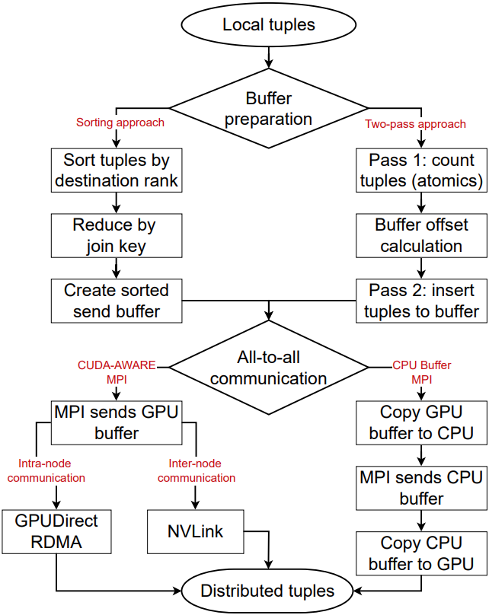
All-to-all communication phases in MNMGDatalog

